Slide 1
Database Management System
How to create new Database and Table in MySQL WorkBench

Slide 2




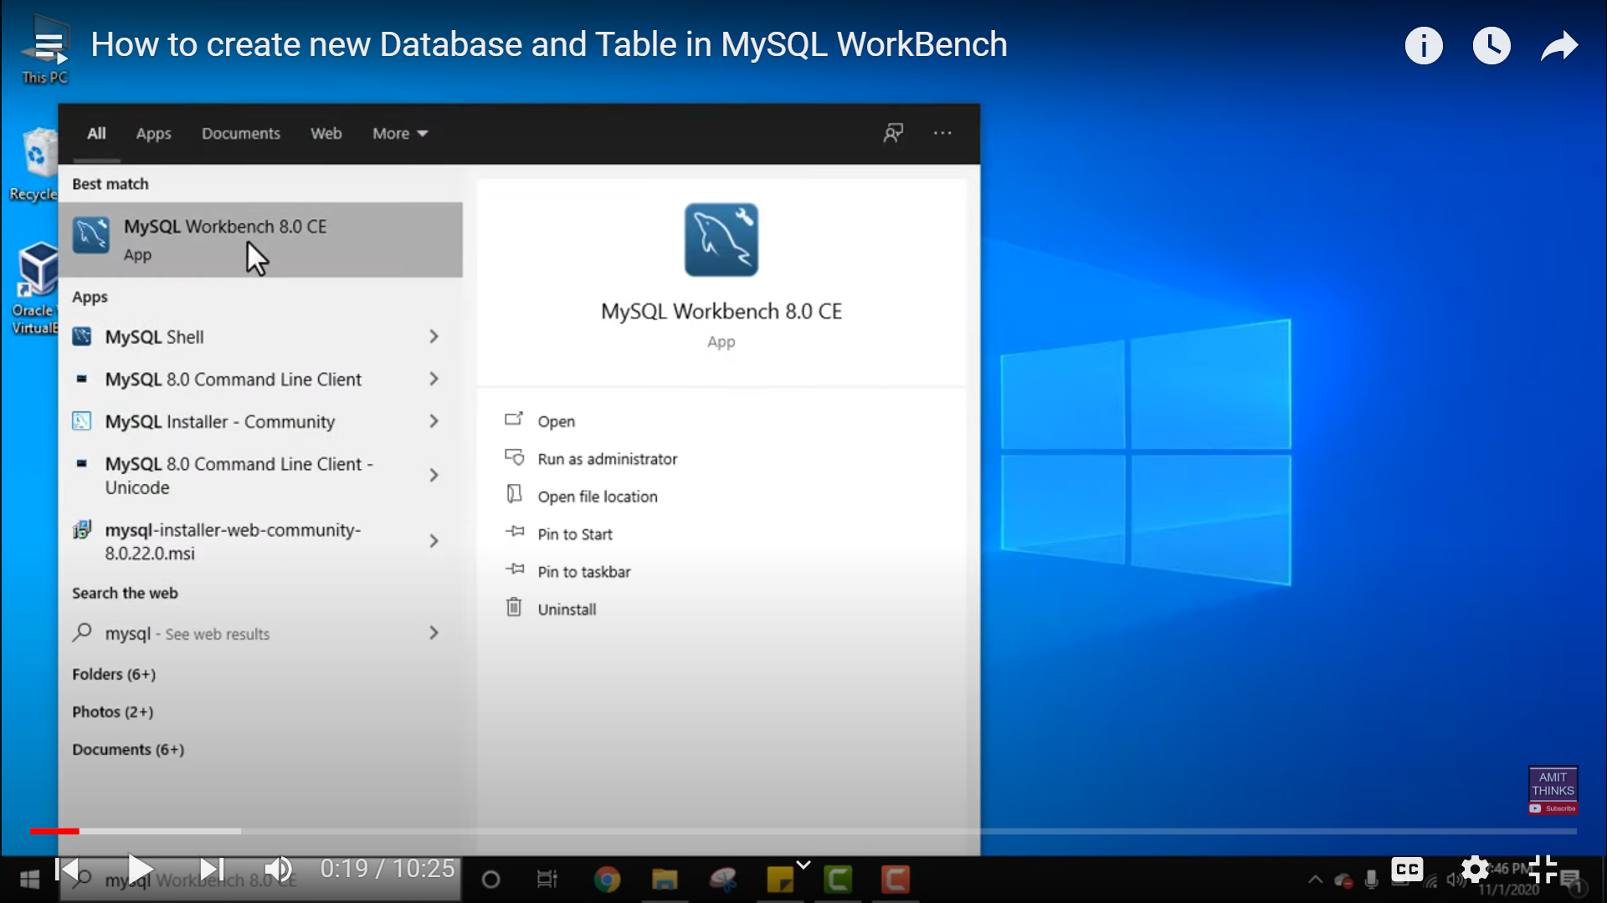
www.tuf.edu.pk
unioffaisalabad

Slide 3
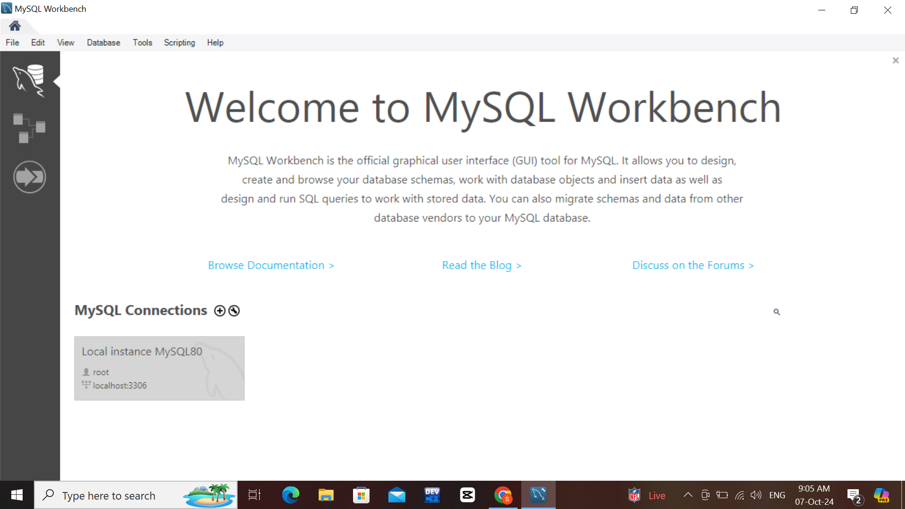

www.tuf.edu.pk
unioffaisalabad

Slide 4

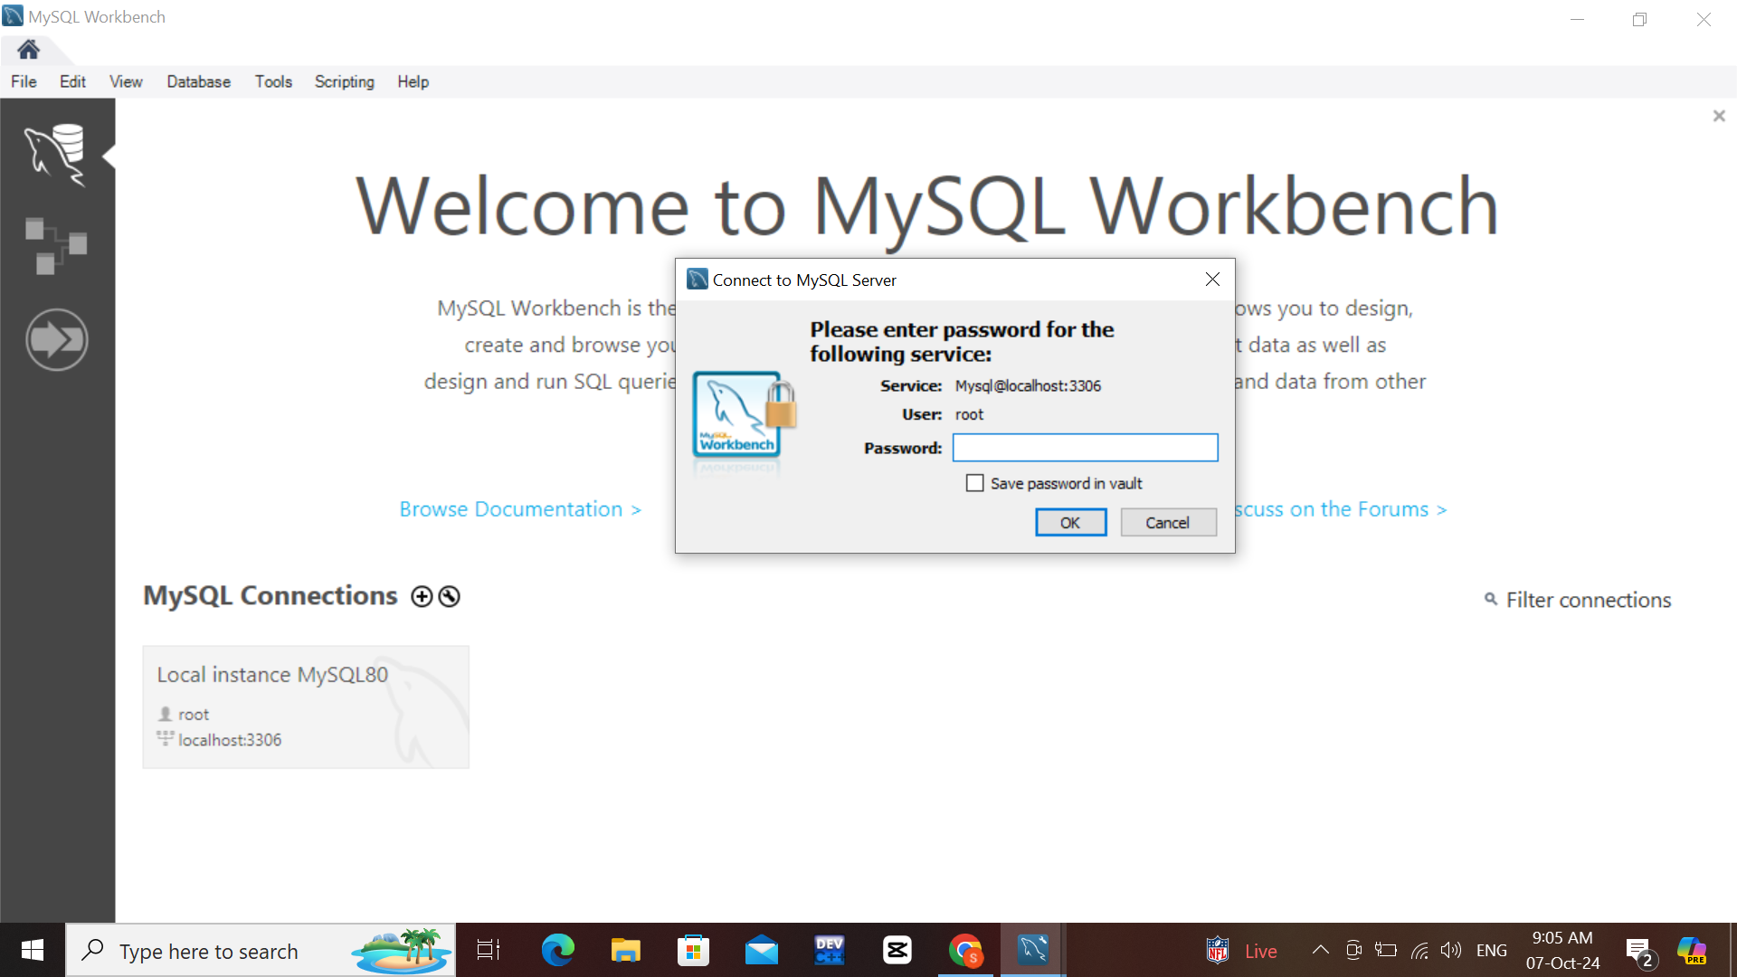
www.tuf.edu.pk
unioffaisalabad

Slide 5
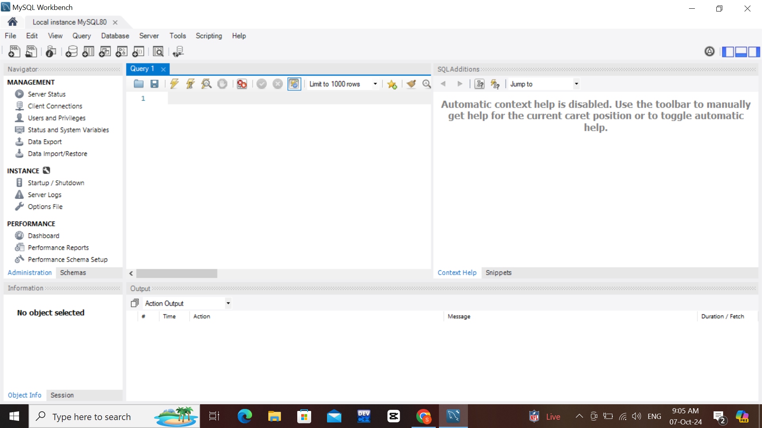
www.tuf.edu.pk
unioffaisalabad

Slide 6
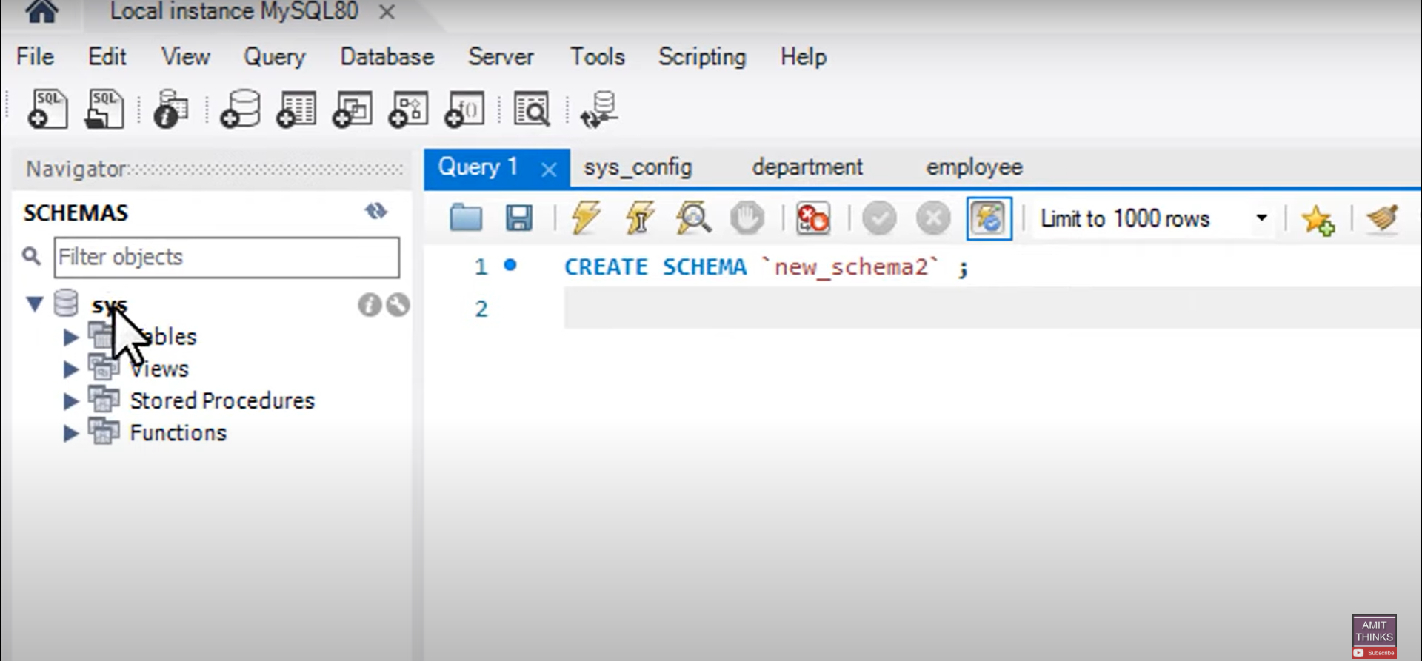
www.tuf.edu.pk
unioffaisalabad

Slide 7
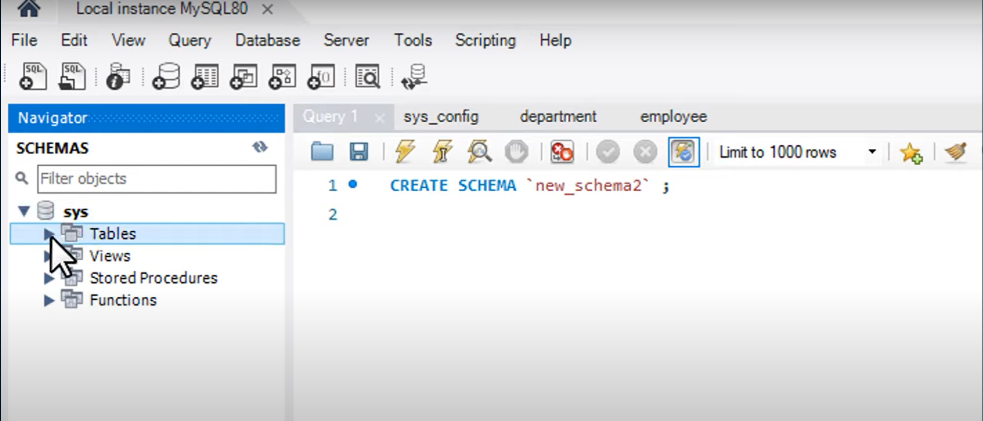
www.tuf.edu.pk
unioffaisalabad

Slide 8
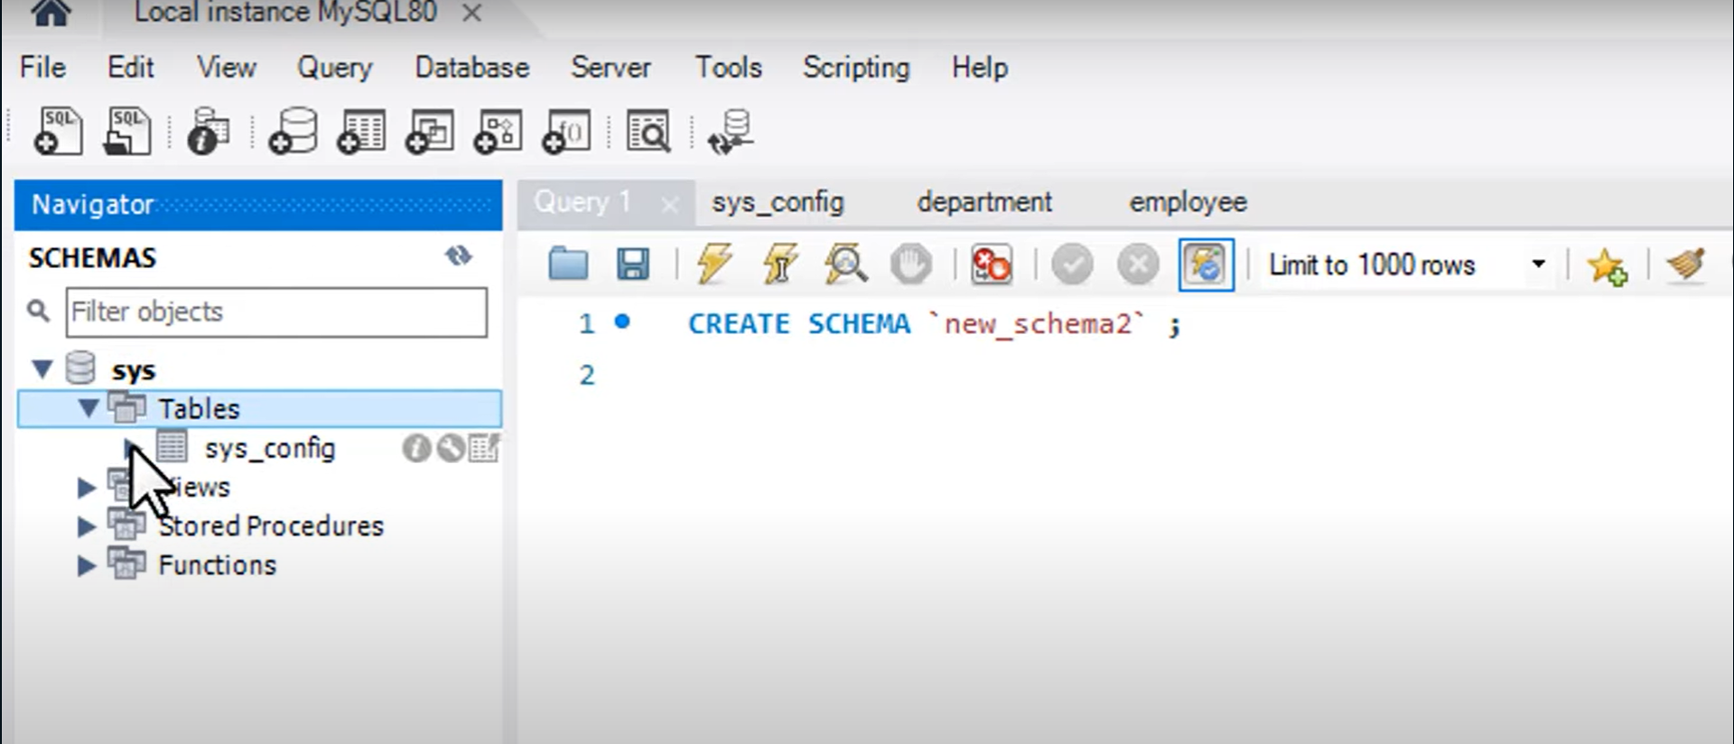
www.tuf.edu.pk
unioffaisalabad

Slide 9
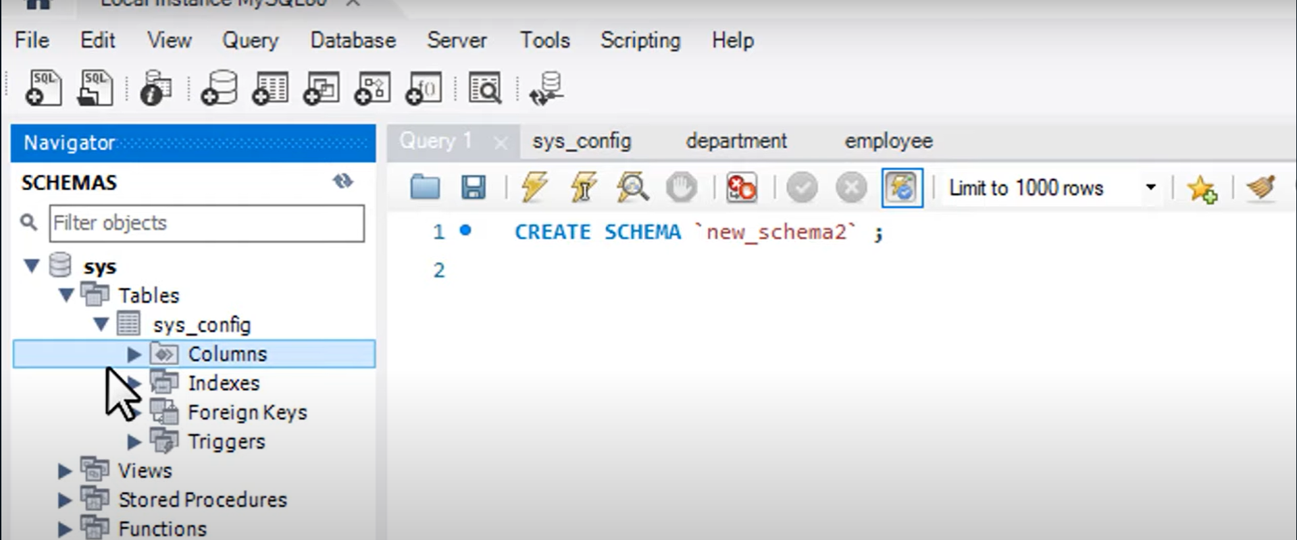
www.tuf.edu.pk
unioffaisalabad

Slide 10
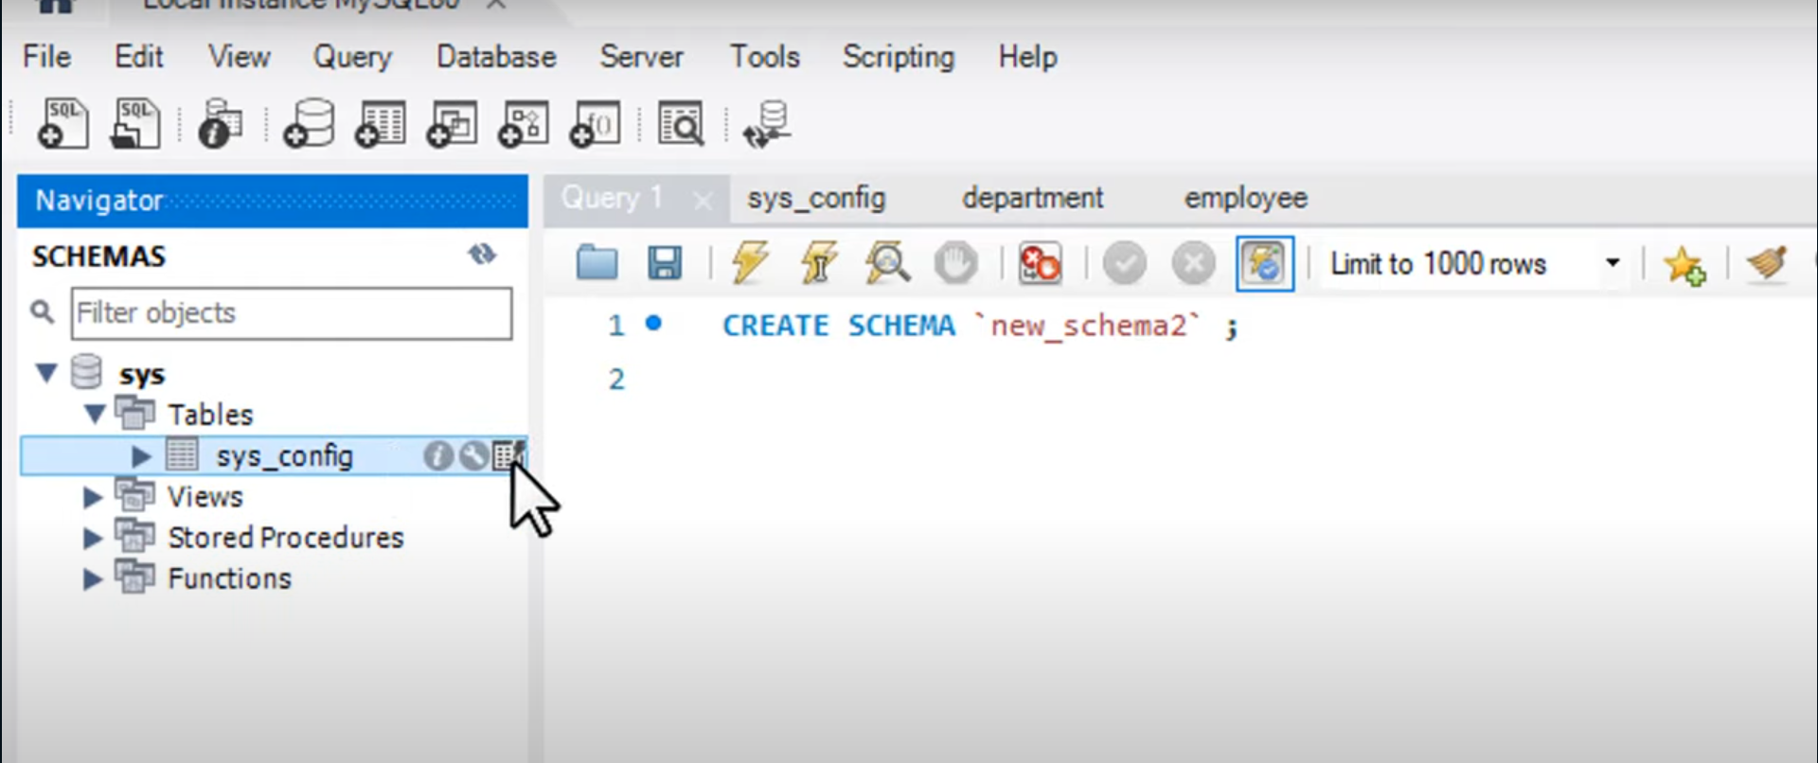
www.tuf.edu.pk
unioffaisalabad

Slide 11
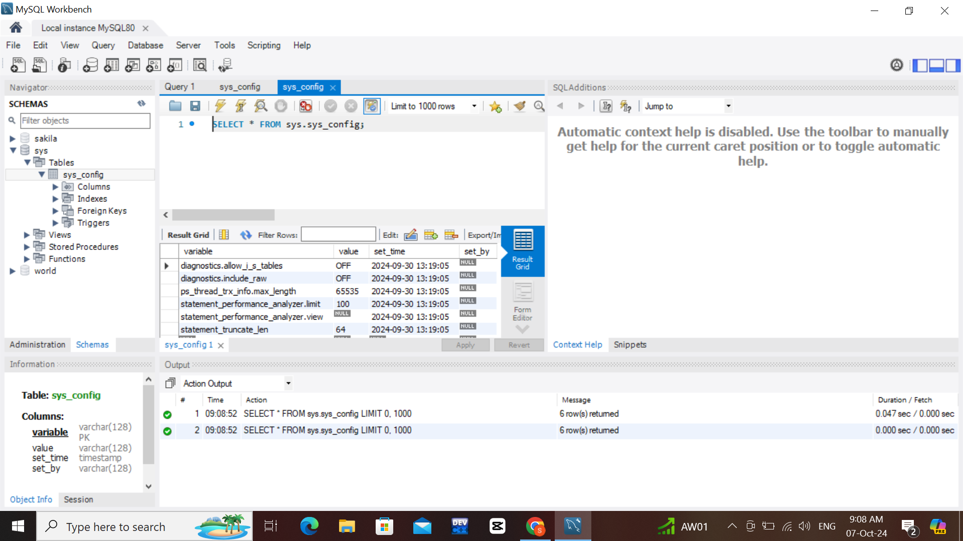
www.tuf.edu.pk
unioffaisalabad

Slide 12
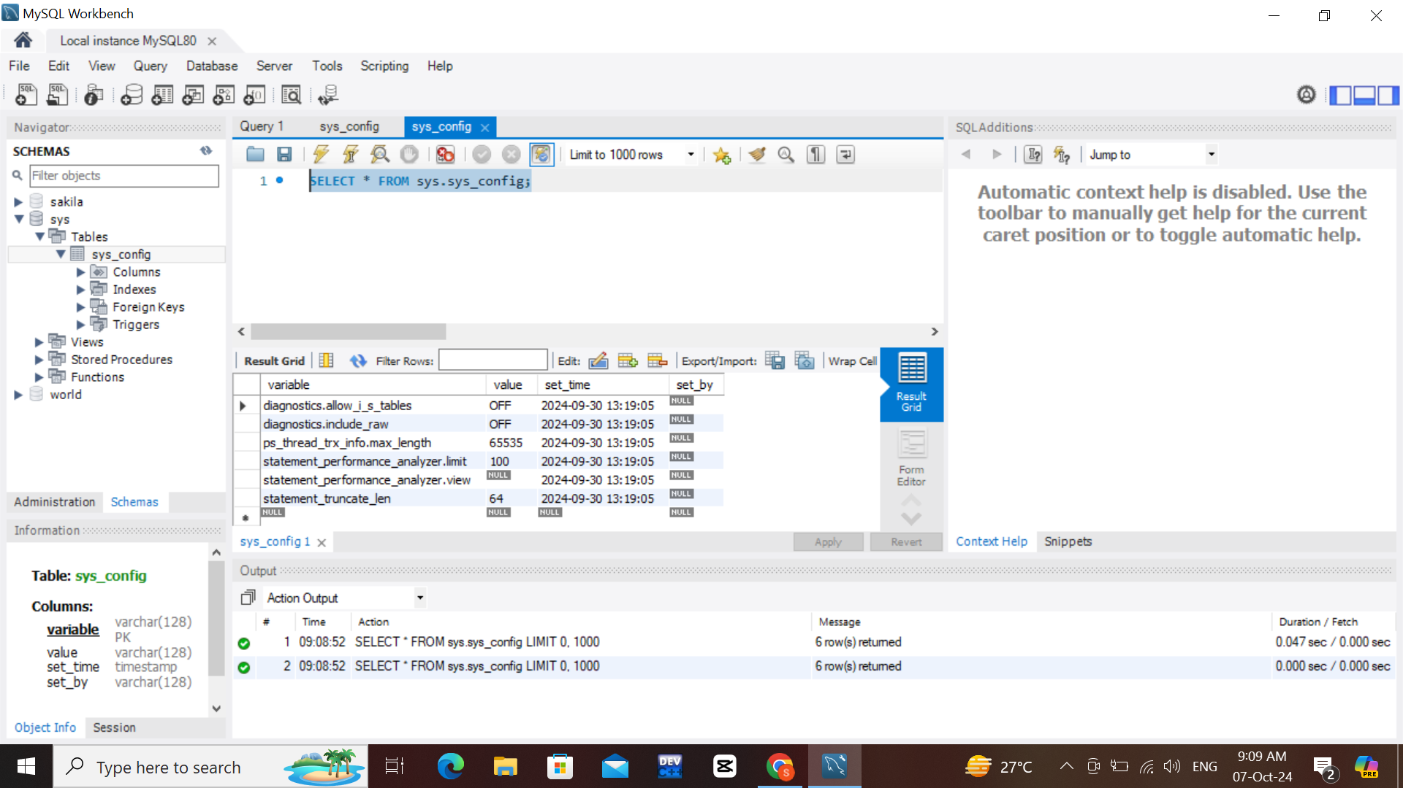
www.tuf.edu.pk
unioffaisalabad

Slide 13
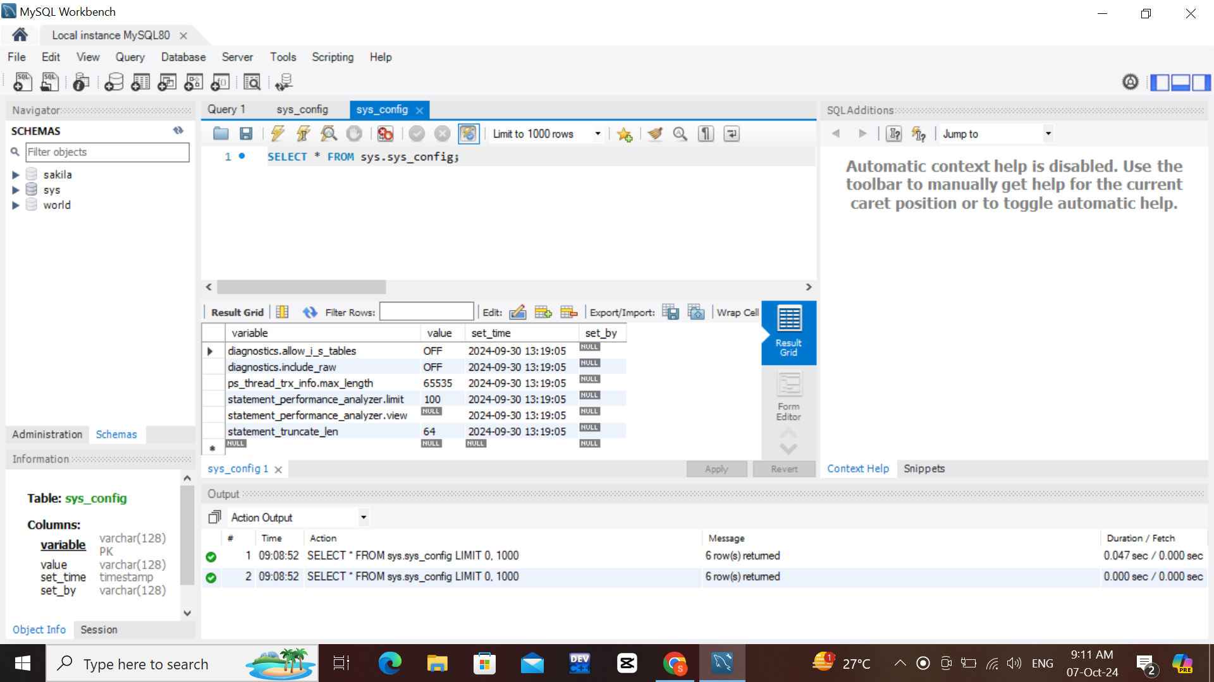
www.tuf.edu.pk
unioffaisalabad

Slide 14
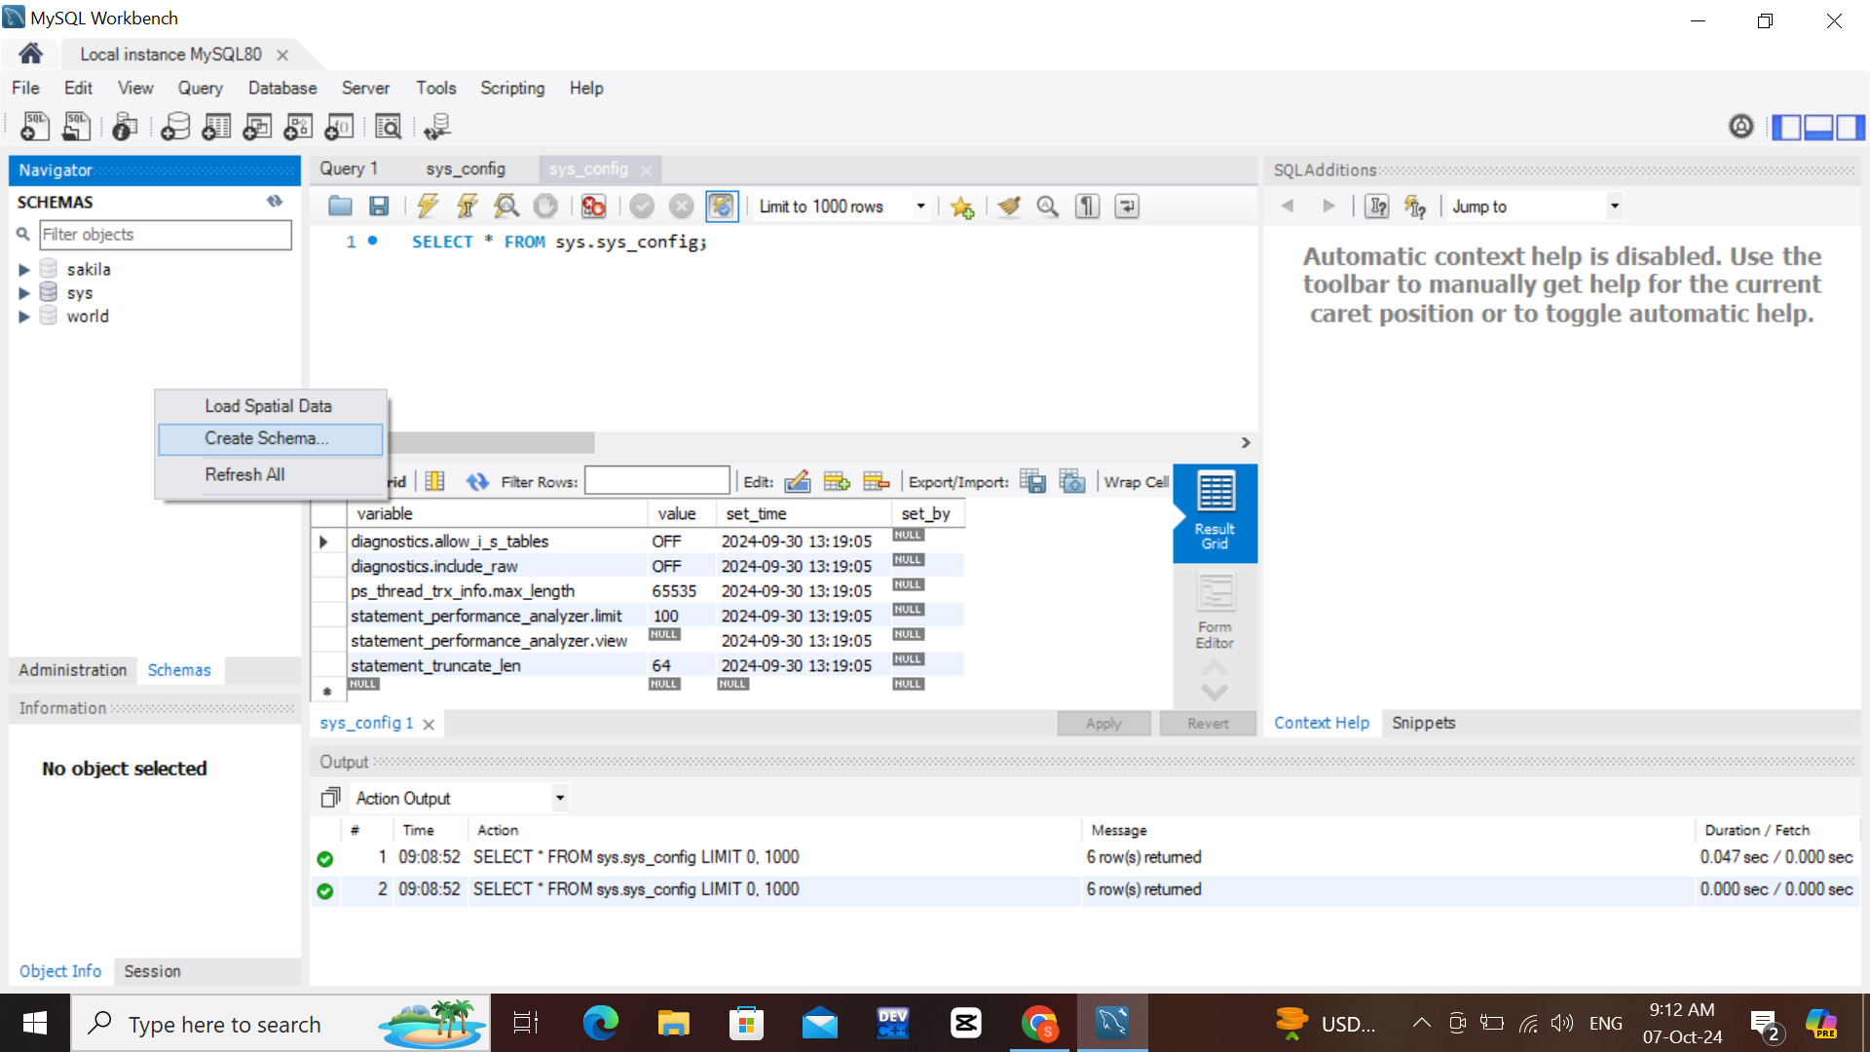
www.tuf.edu.pk
unioffaisalabad

Slide 15
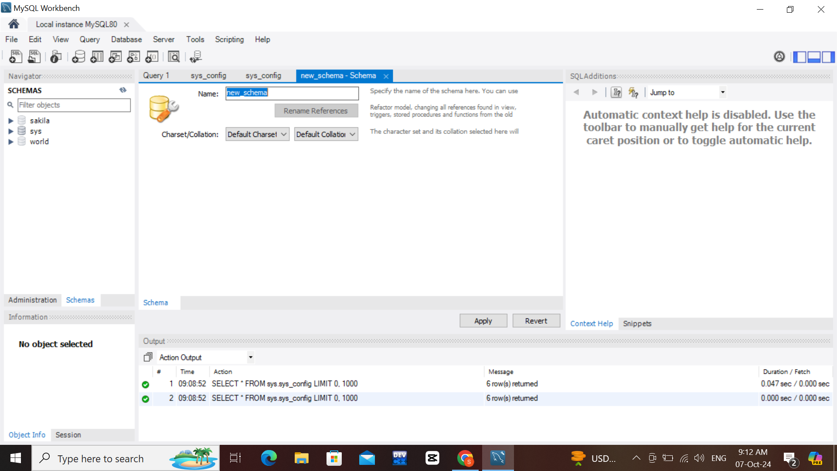
www.tuf.edu.pk
unioffaisalabad

Slide 16
www.tuf.edu.pk
unioffaisalabad

Slide 17
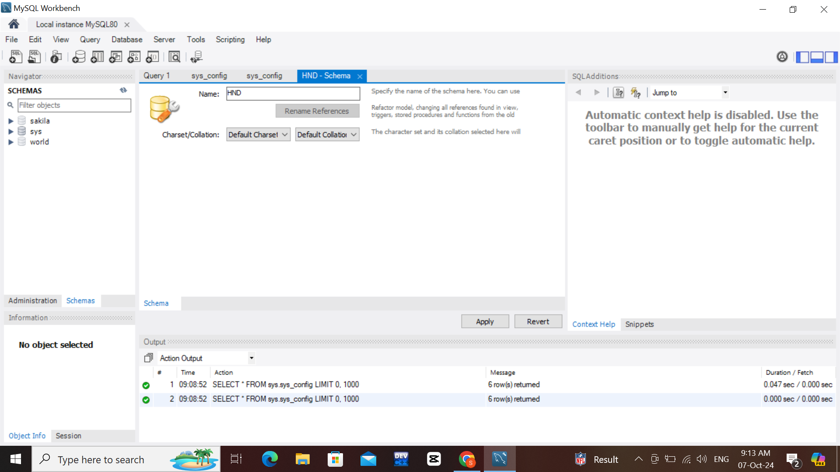
www.tuf.edu.pk
unioffaisalabad

Slide 18

www.tuf.edu.pk
unioffaisalabad

Slide 19
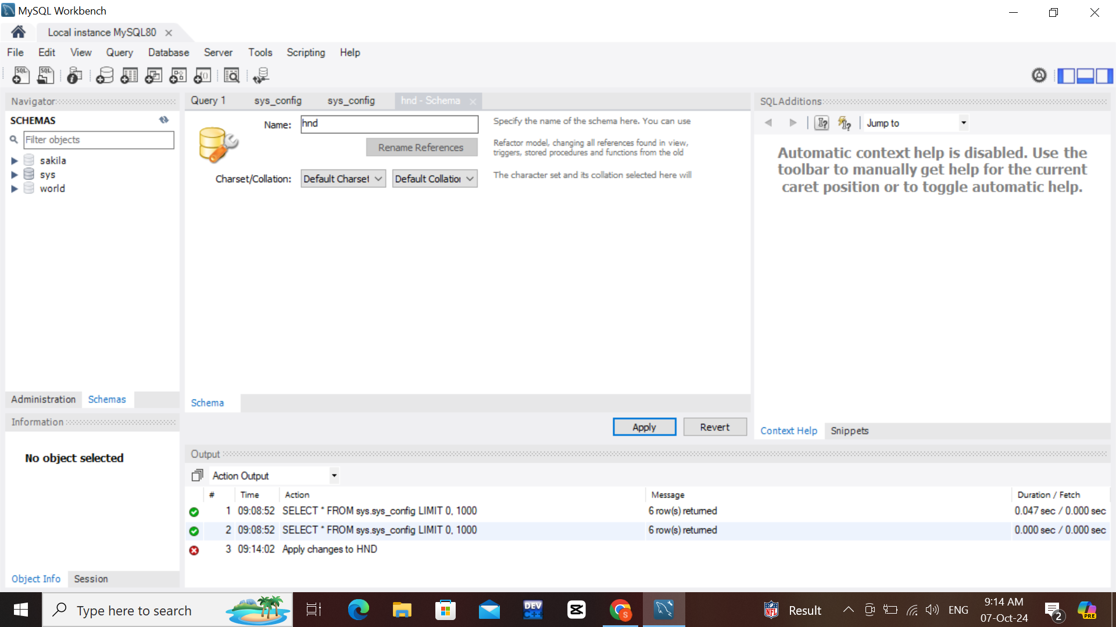
www.tuf.edu.pk
unioffaisalabad

Slide 20
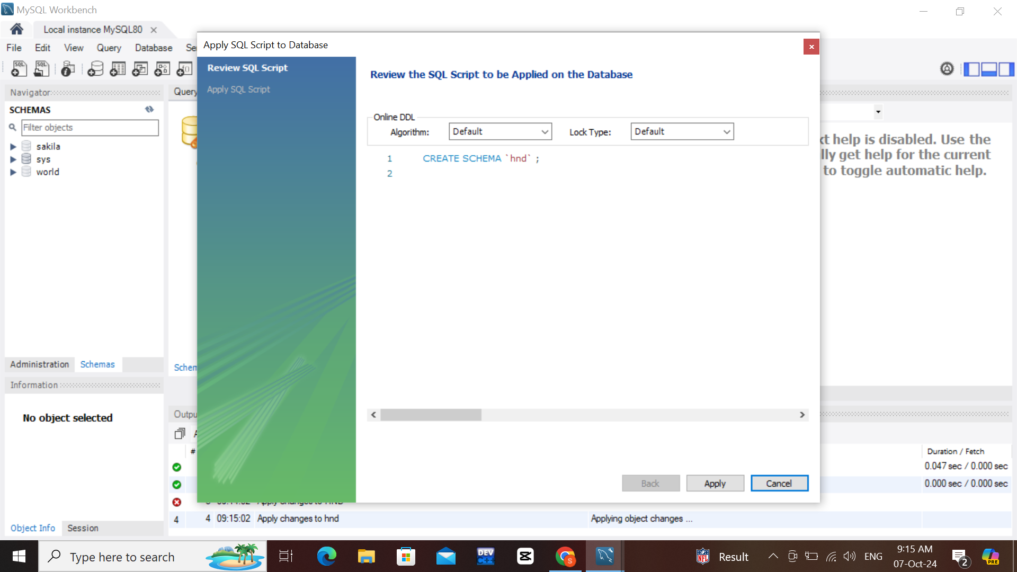
www.tuf.edu.pk
unioffaisalabad

Slide 21

www.tuf.edu.pk
unioffaisalabad

Slide 22
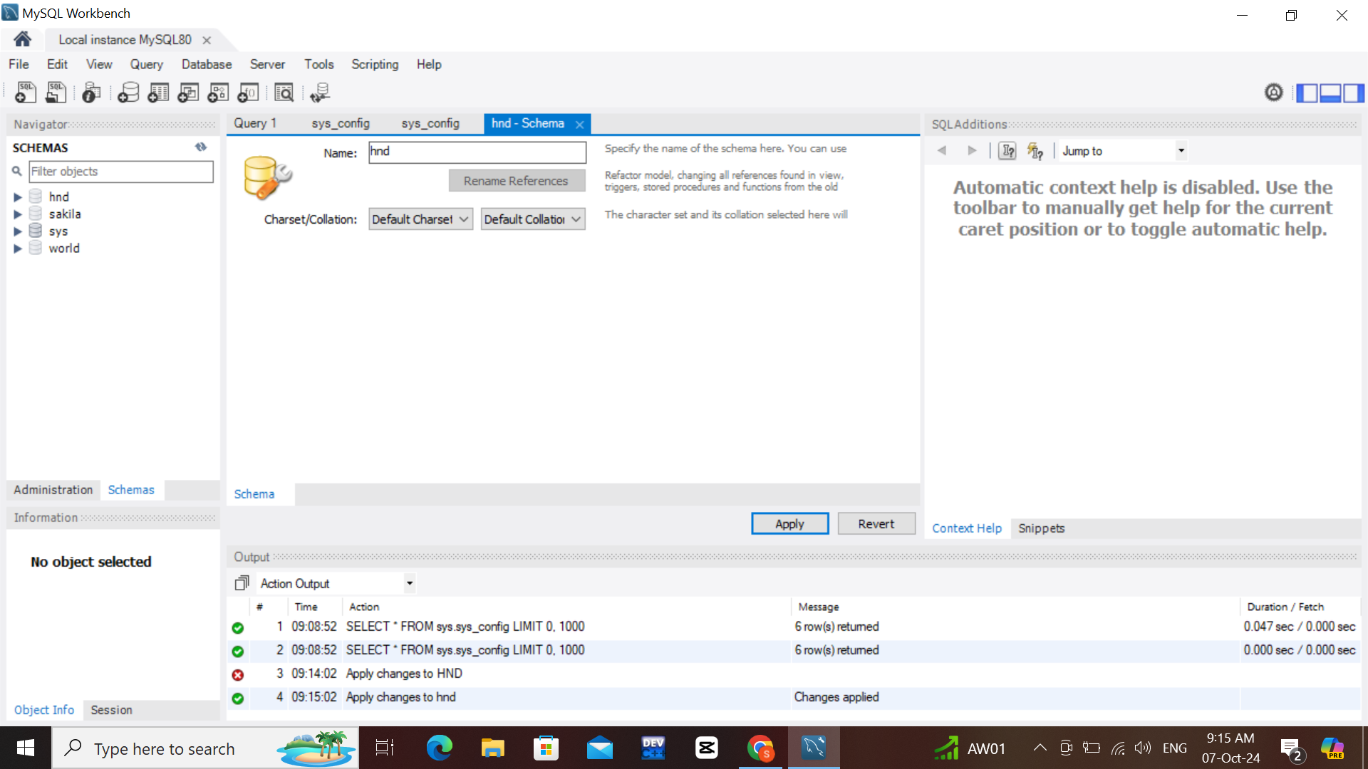
www.tuf.edu.pk
unioffaisalabad

Slide 23
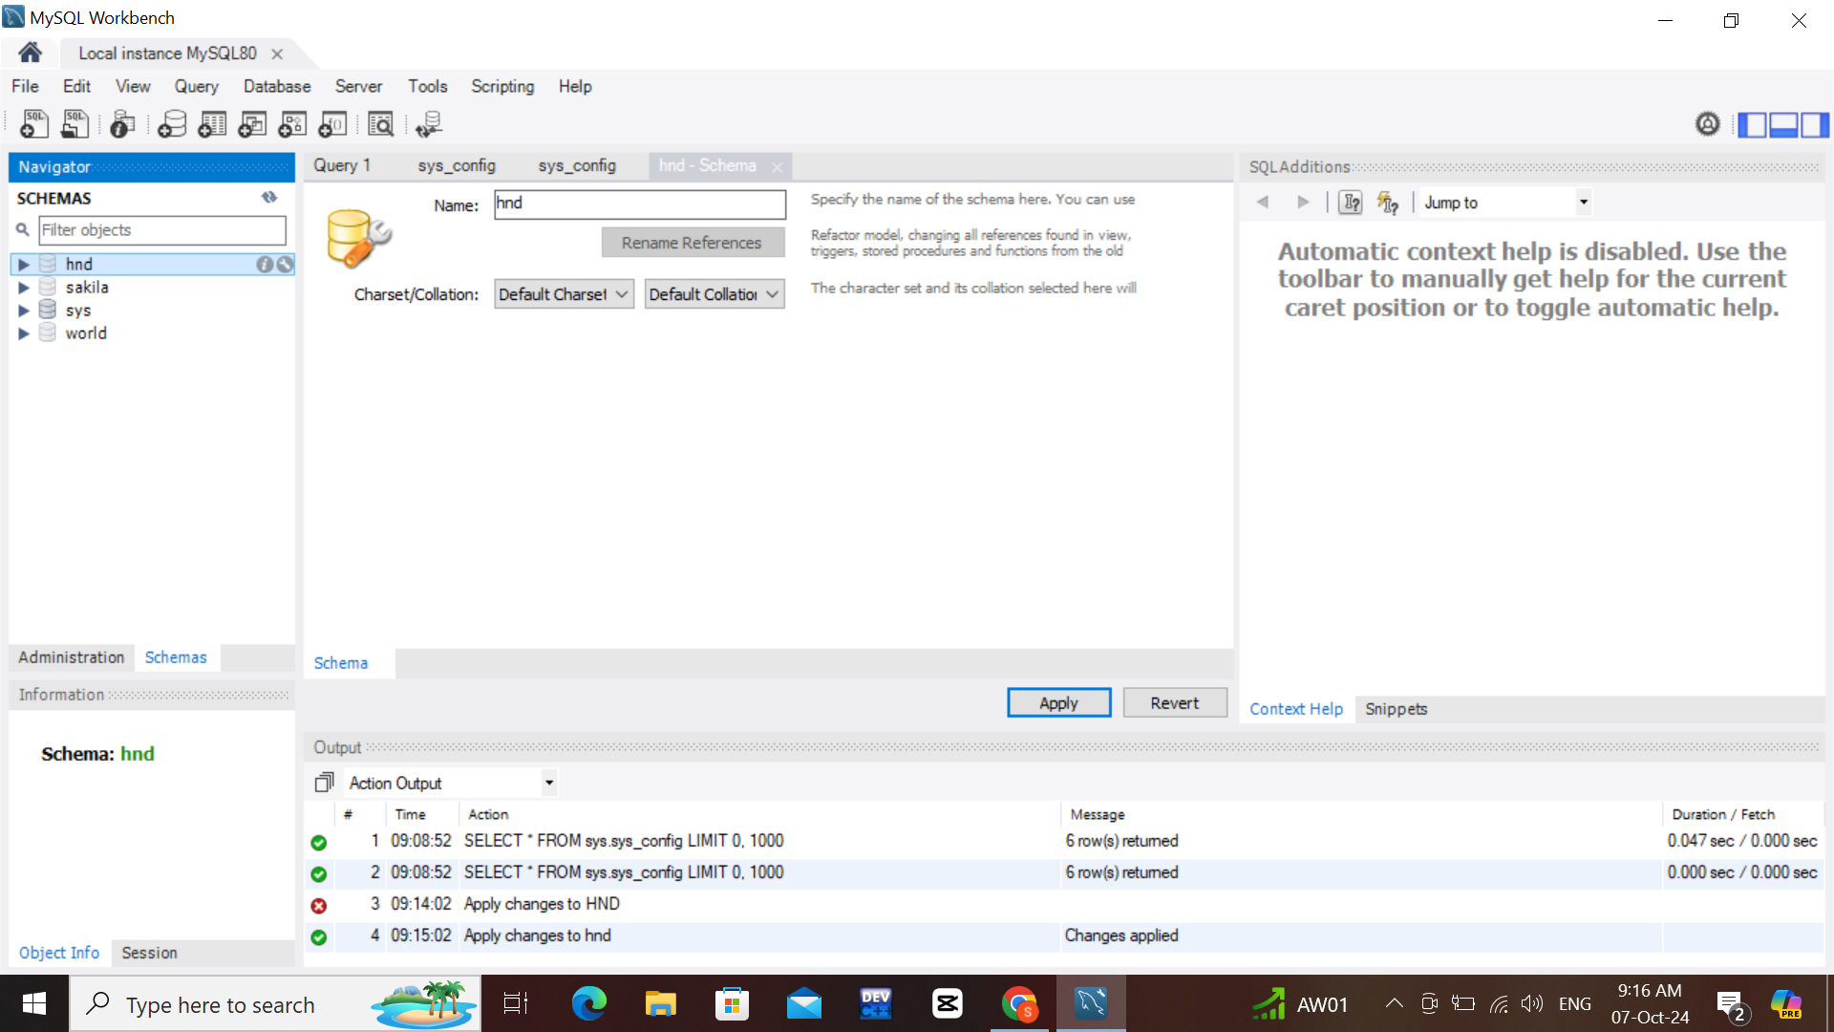
www.tuf.edu.pk
unioffaisalabad

Slide 24
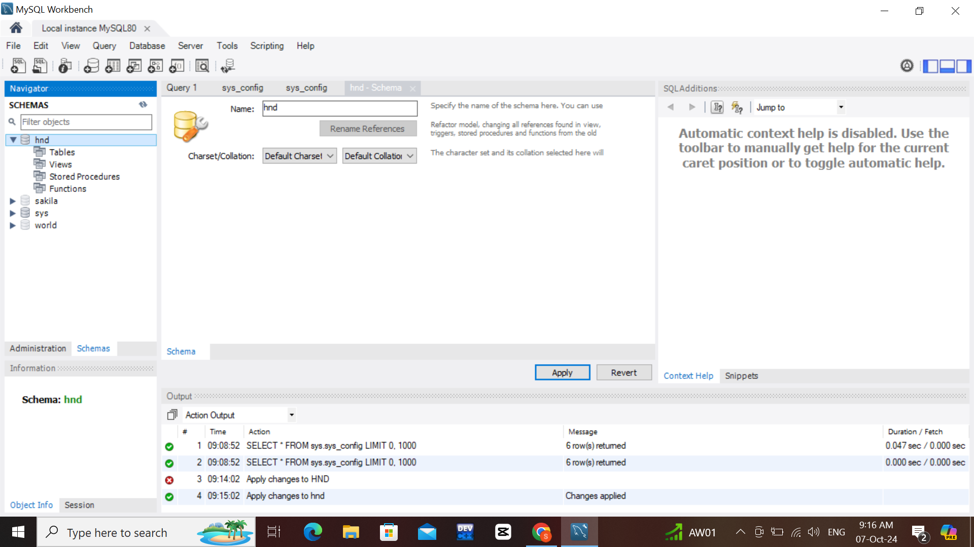
www.tuf.edu.pk
unioffaisalabad

Slide 25
www.tuf.edu.pk
unioffaisalabad

Slide 26

www.tuf.edu.pk
unioffaisalabad

Slide 27
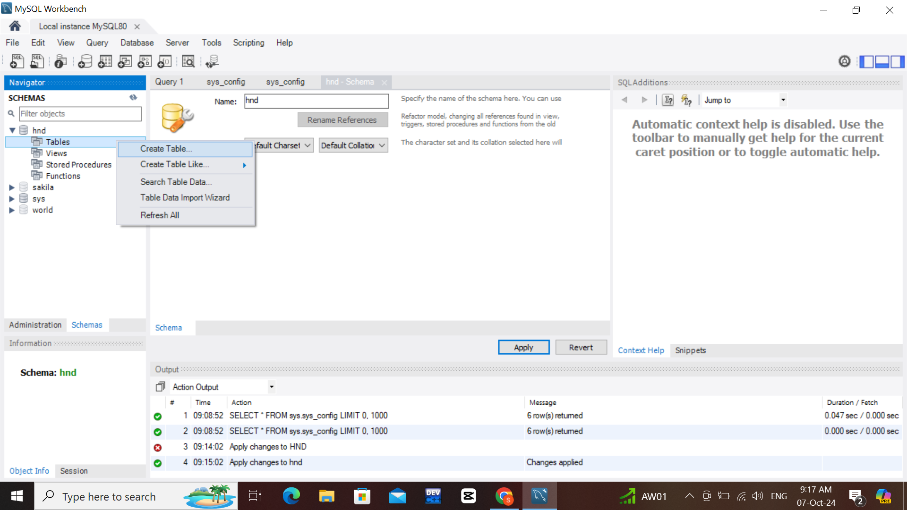
www.tuf.edu.pk
unioffaisalabad

Slide 28
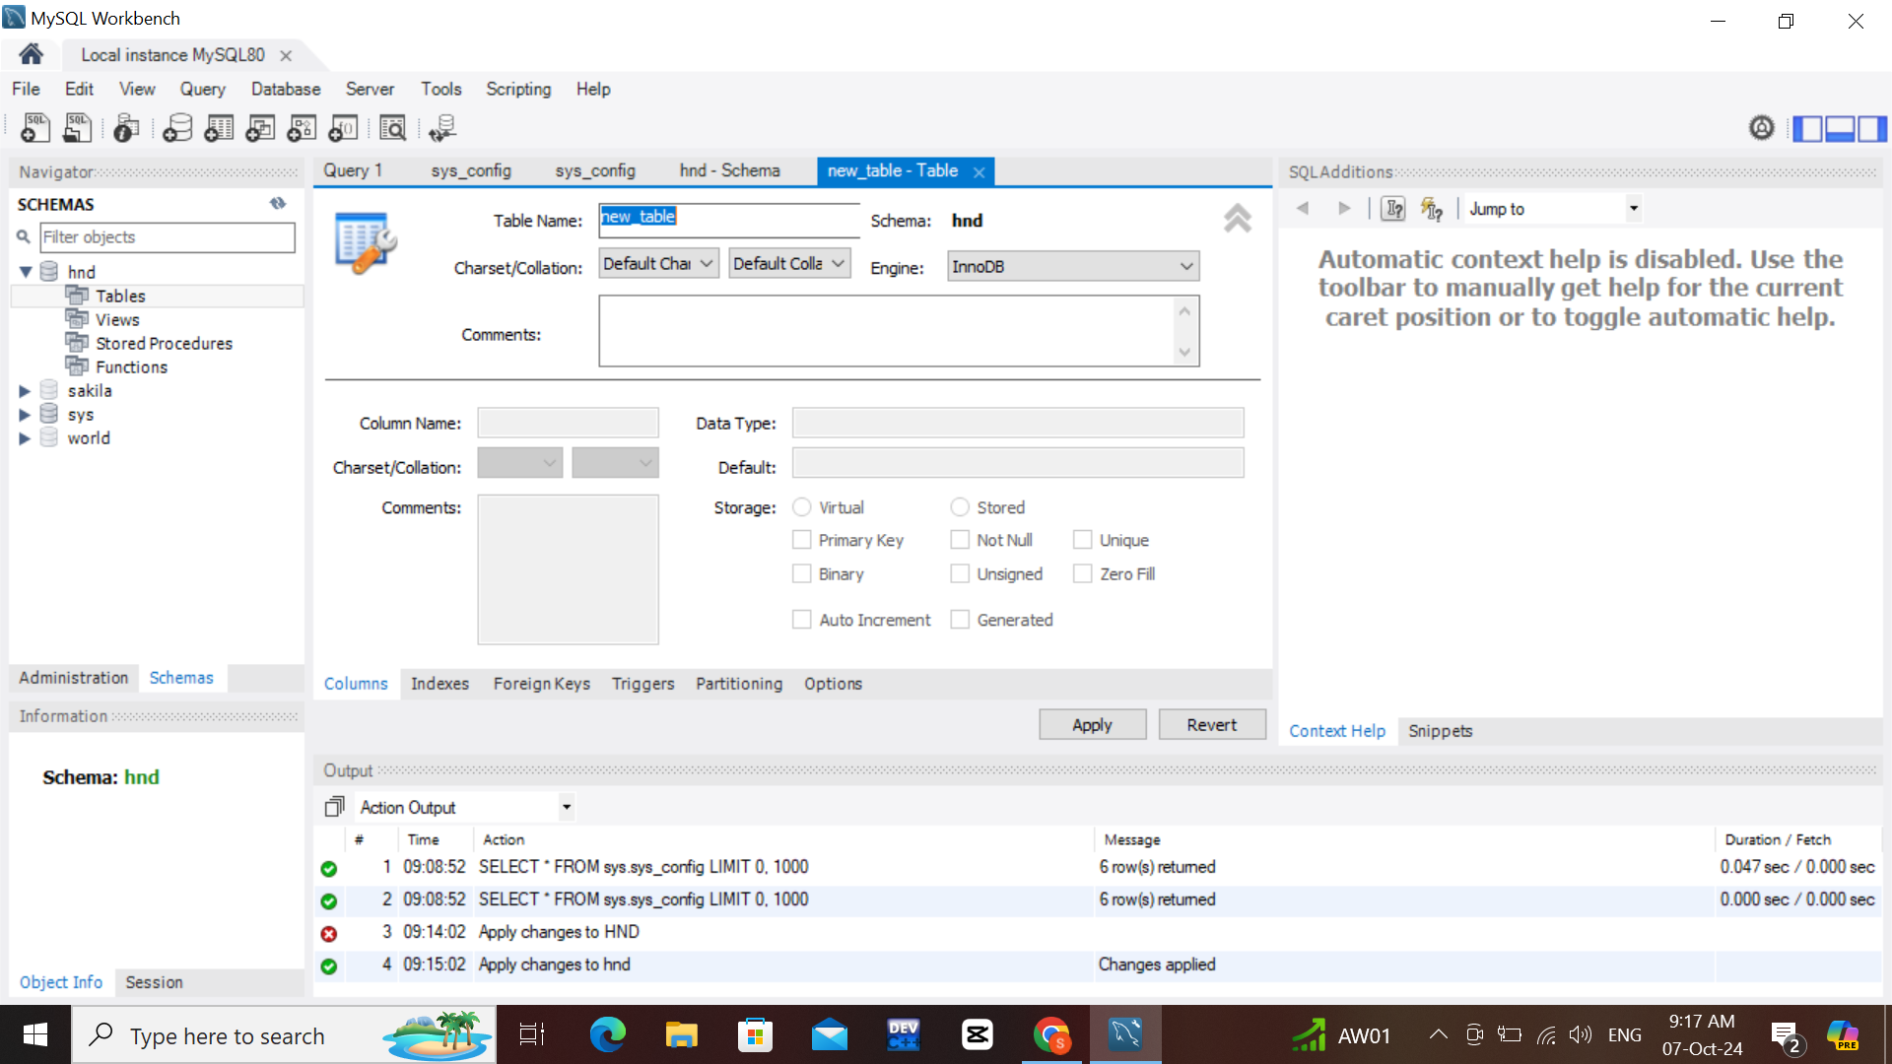
www.tuf.edu.pk
unioffaisalabad

Slide 29
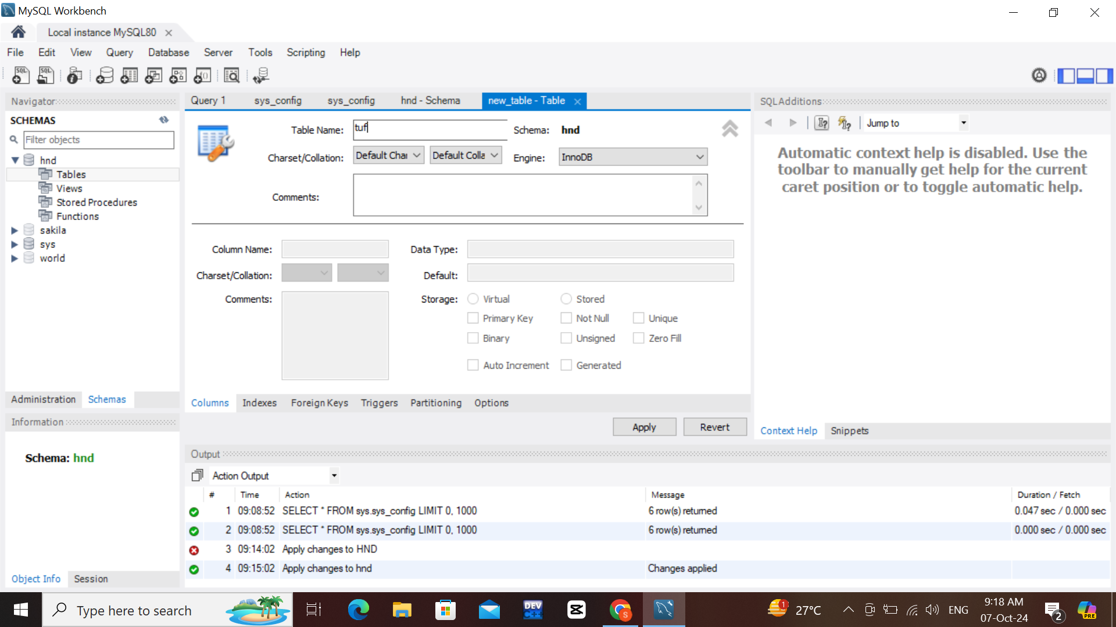
www.tuf.edu.pk
unioffaisalabad

Slide 30
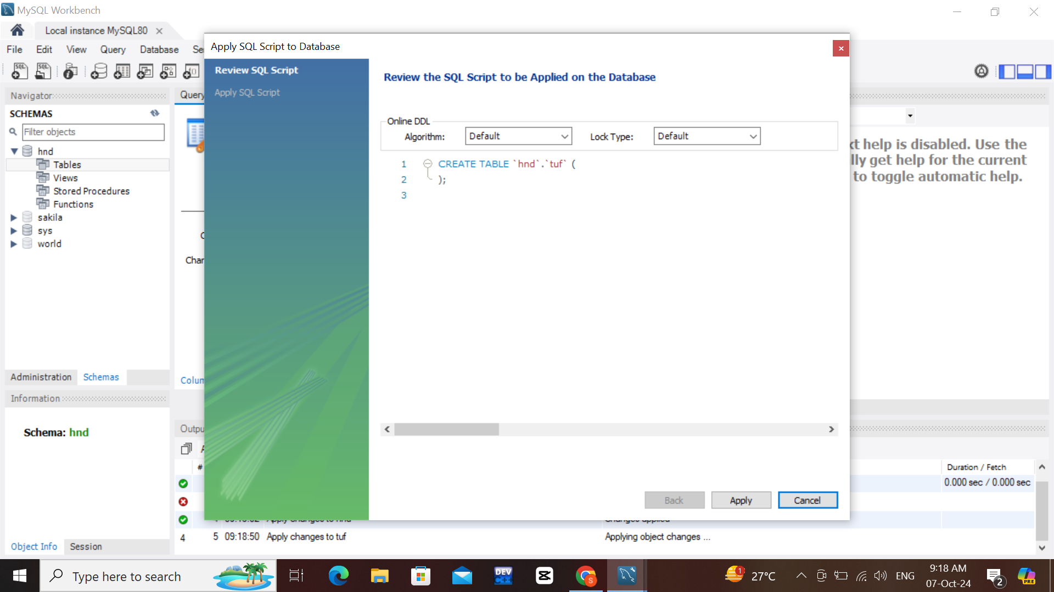
www.tuf.edu.pk
unioffaisalabad

Slide 31
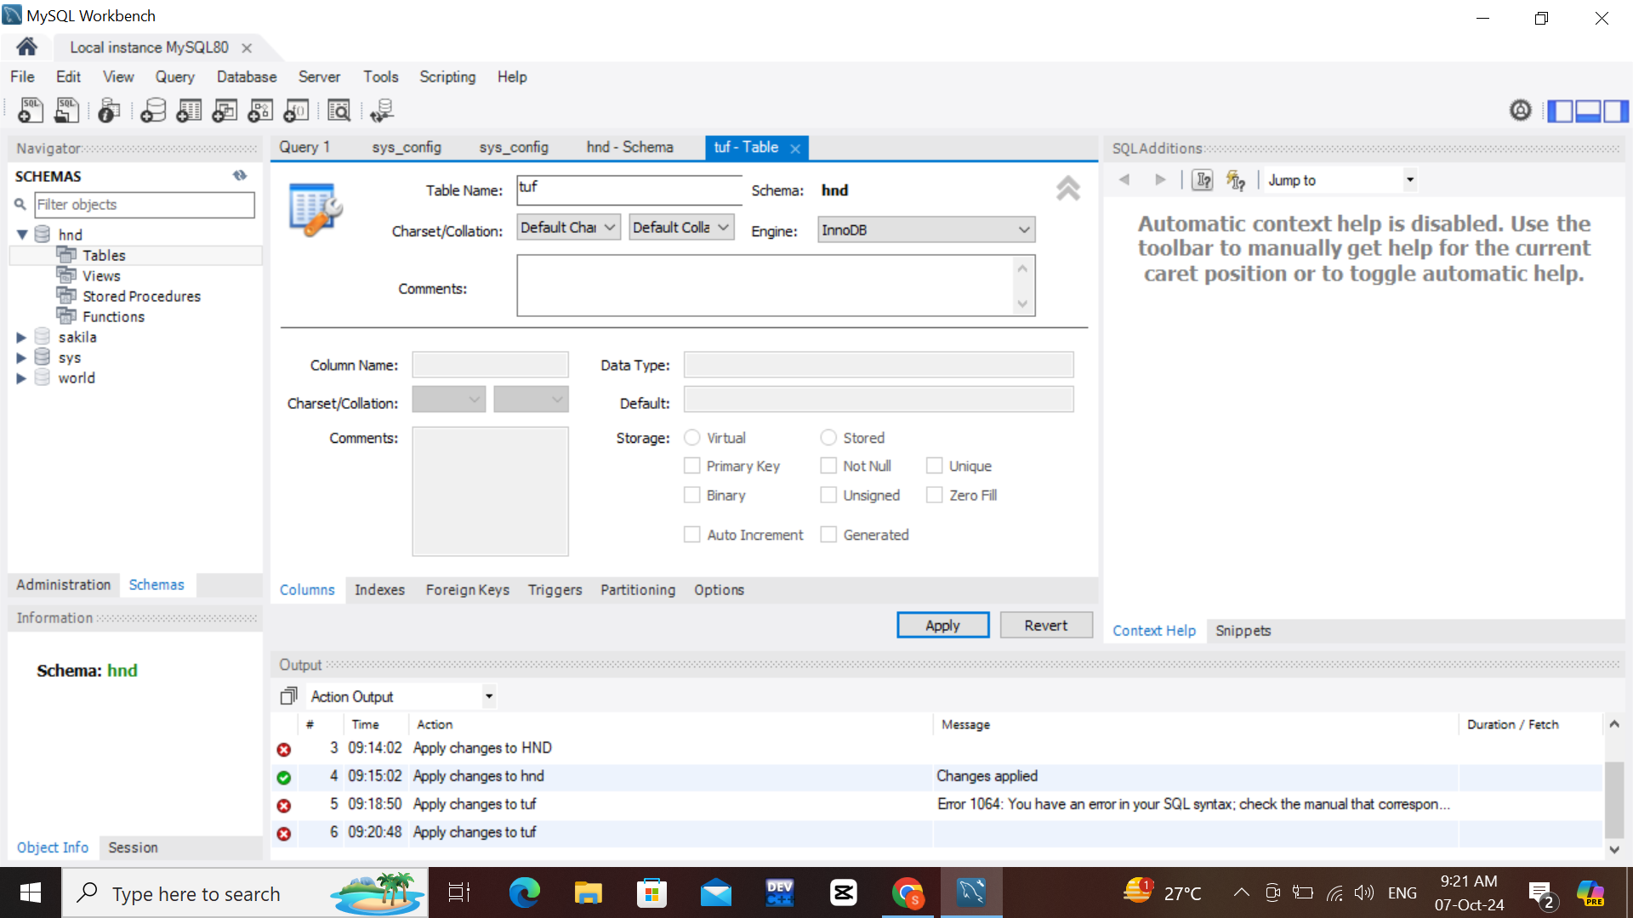
www.tuf.edu.pk
unioffaisalabad

Slide 32
www.tuf.edu.pk
unioffaisalabad

Slide 33
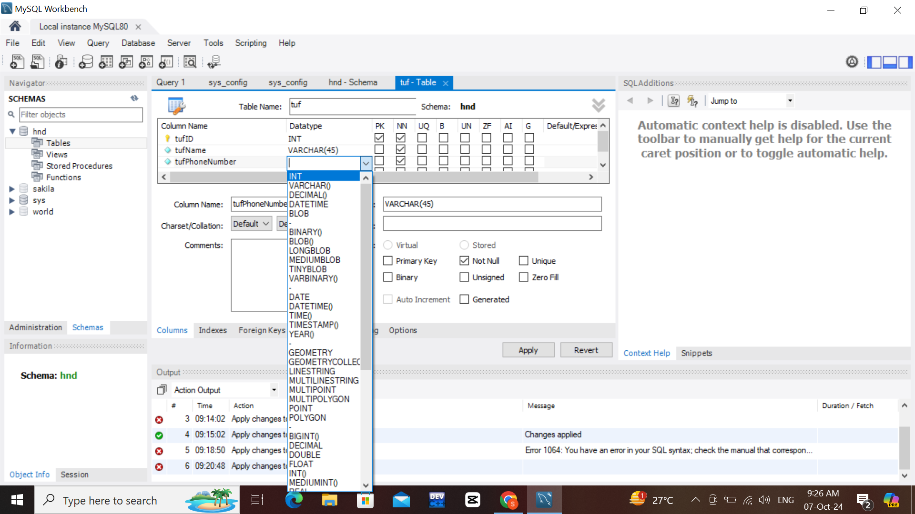
www.tuf.edu.pk
unioffaisalabad

Slide 34
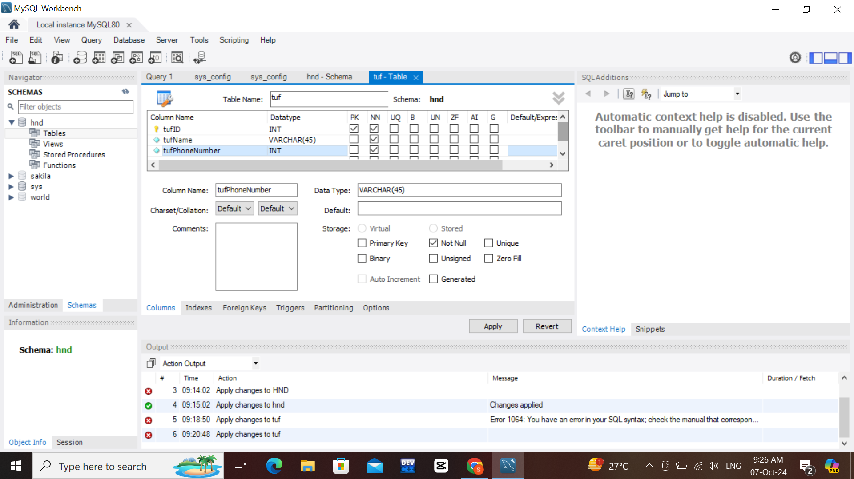
www.tuf.edu.pk
unioffaisalabad

Slide 35
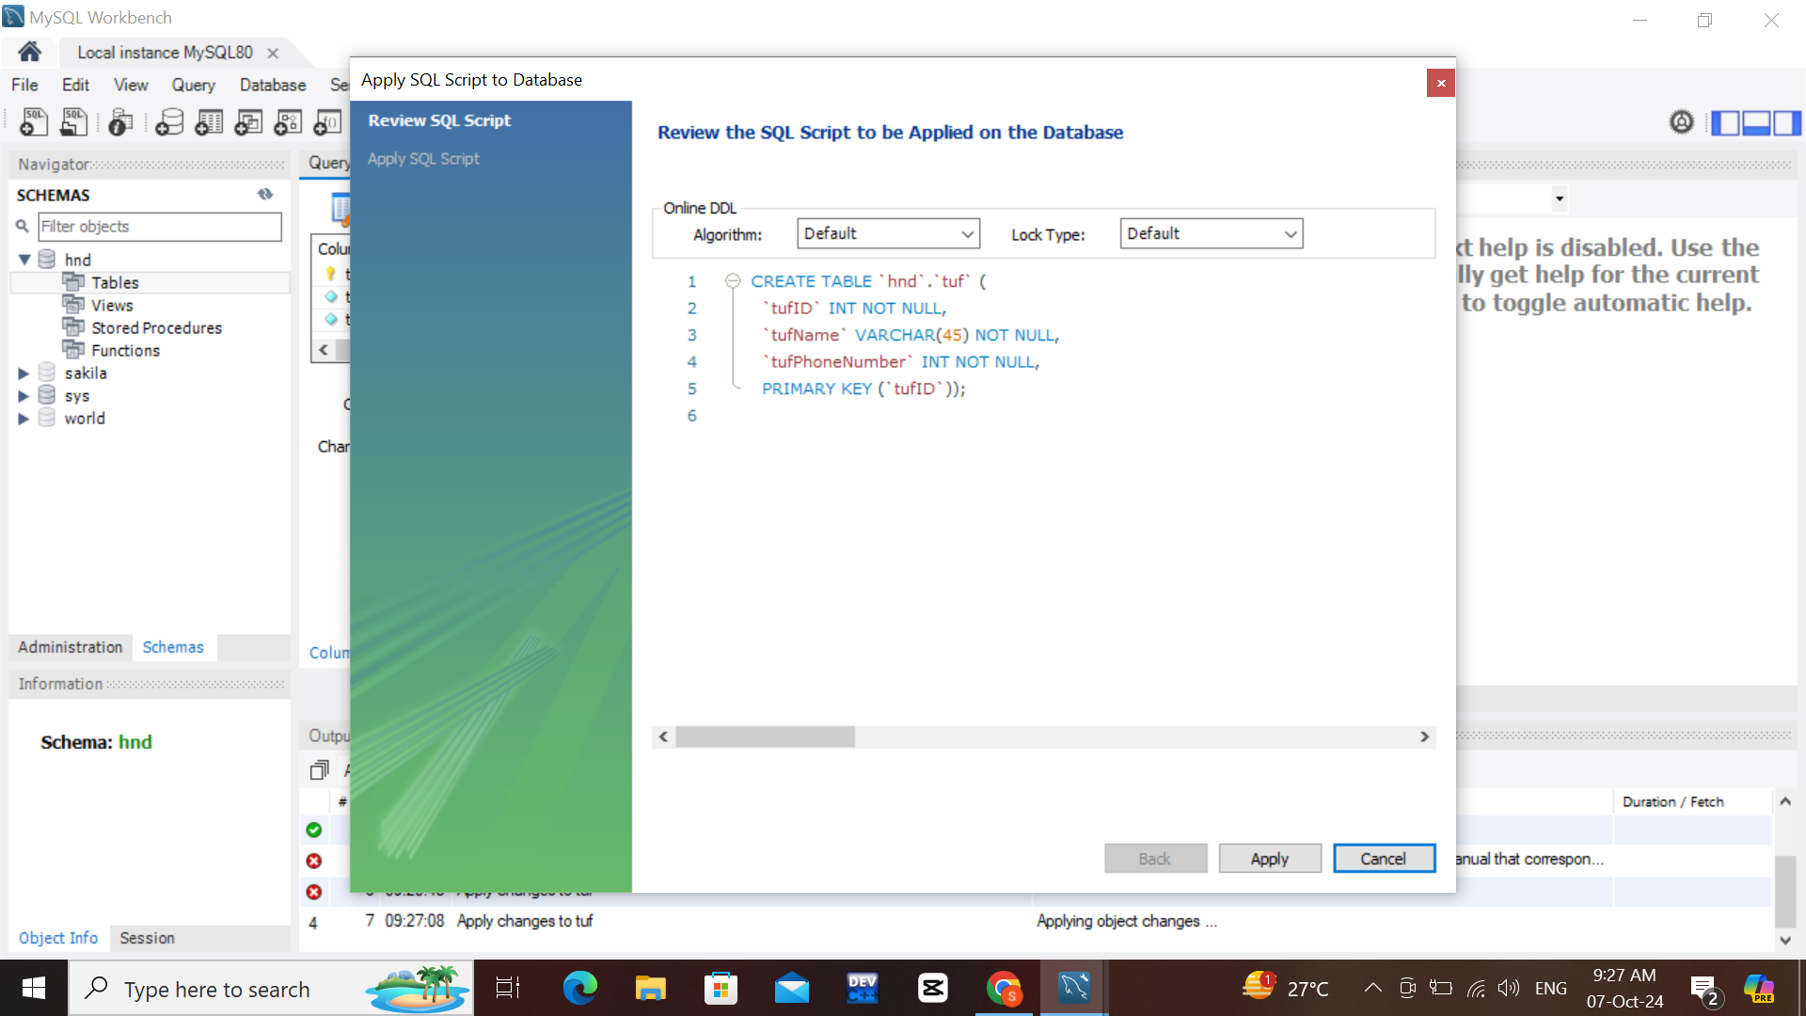
www.tuf.edu.pk
unioffaisalabad

Slide 36

www.tuf.edu.pk
unioffaisalabad

Slide 37
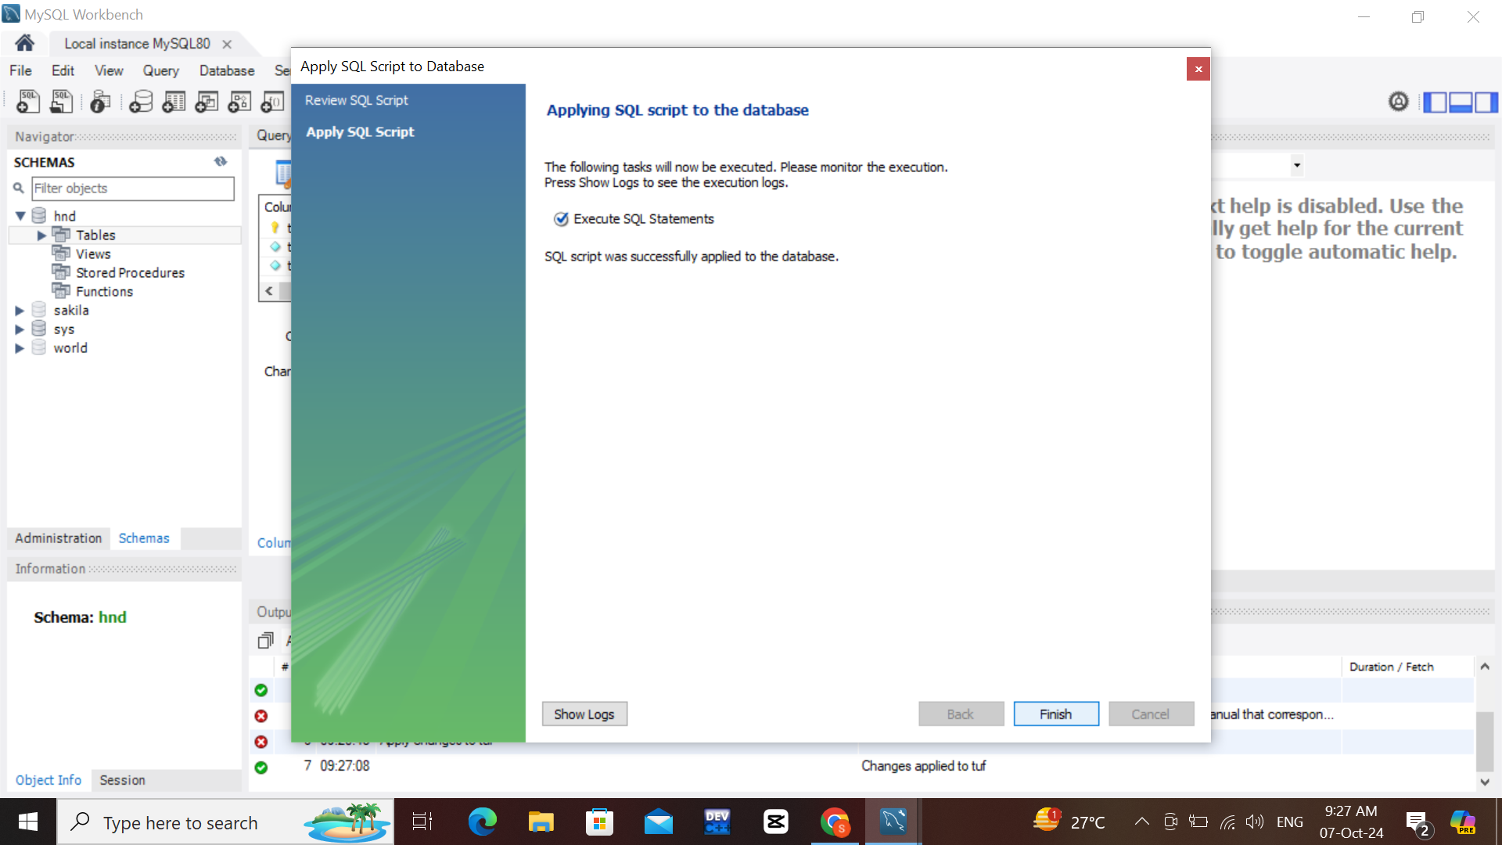
www.tuf.edu.pk
unioffaisalabad

Slide 38
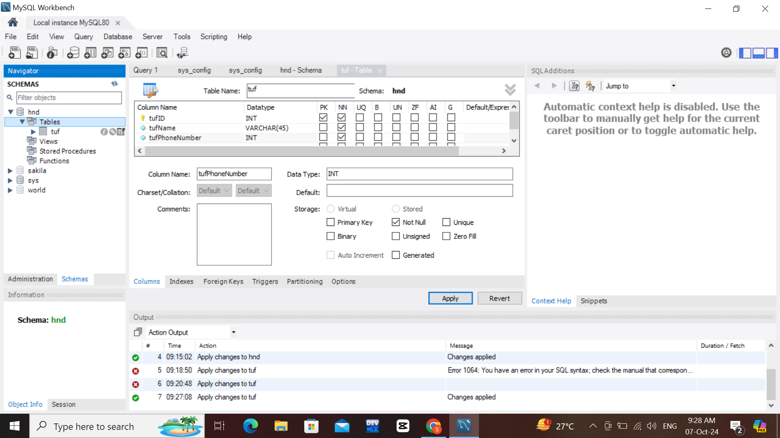
www.tuf.edu.pk
unioffaisalabad

Slide 39
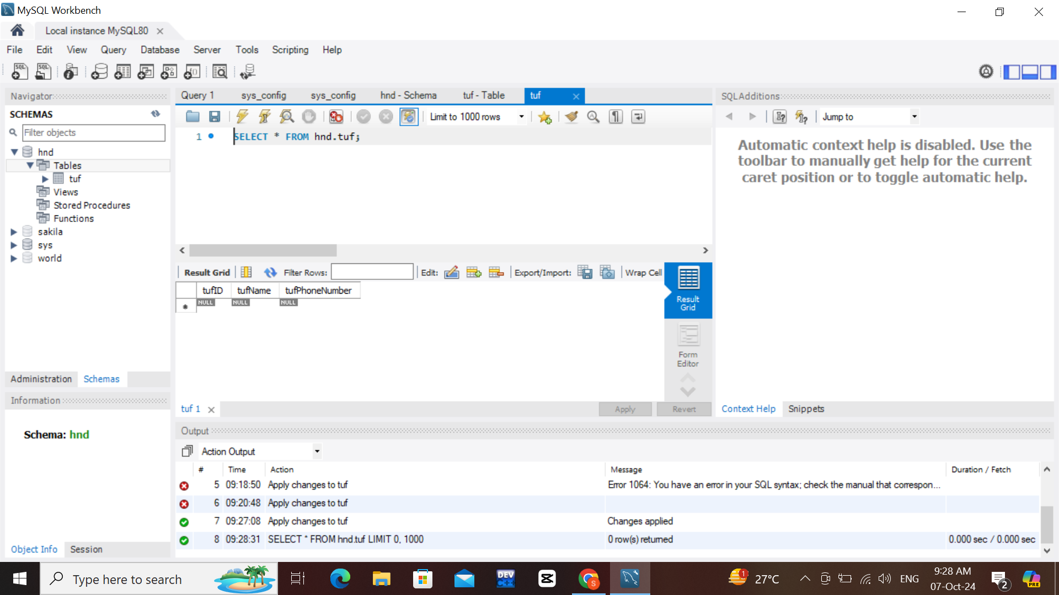
www.tuf.edu.pk
unioffaisalabad

Slide 40

www.tuf.edu.pk
unioffaisalabad

Slide 41

www.tuf.edu.pk
unioffaisalabad

Slide 42

www.tuf.edu.pk
unioffaisalabad

Slide 43
www.tuf.edu.pk
unioffaisalabad

Slide 44
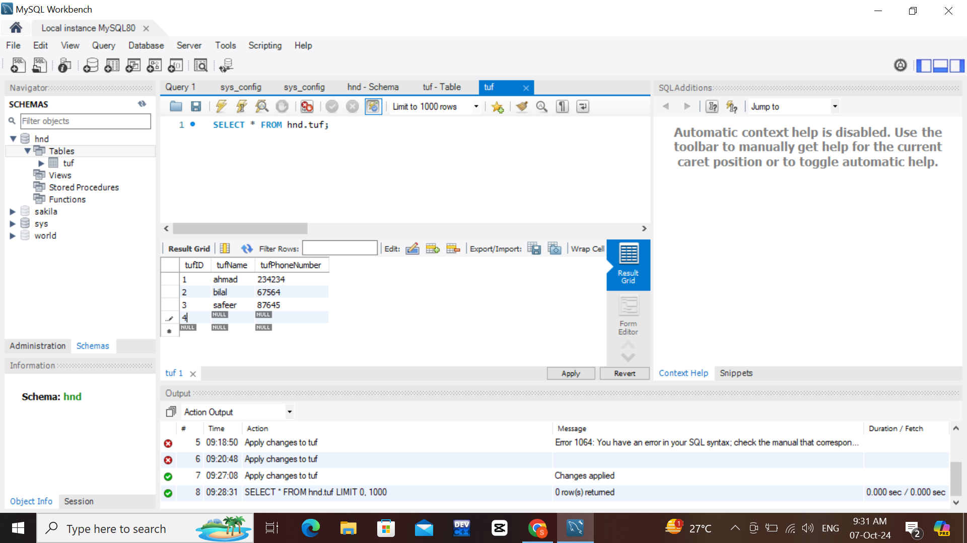
www.tuf.edu.pk
unioffaisalabad

Slide 45

www.tuf.edu.pk
unioffaisalabad

Slide 46
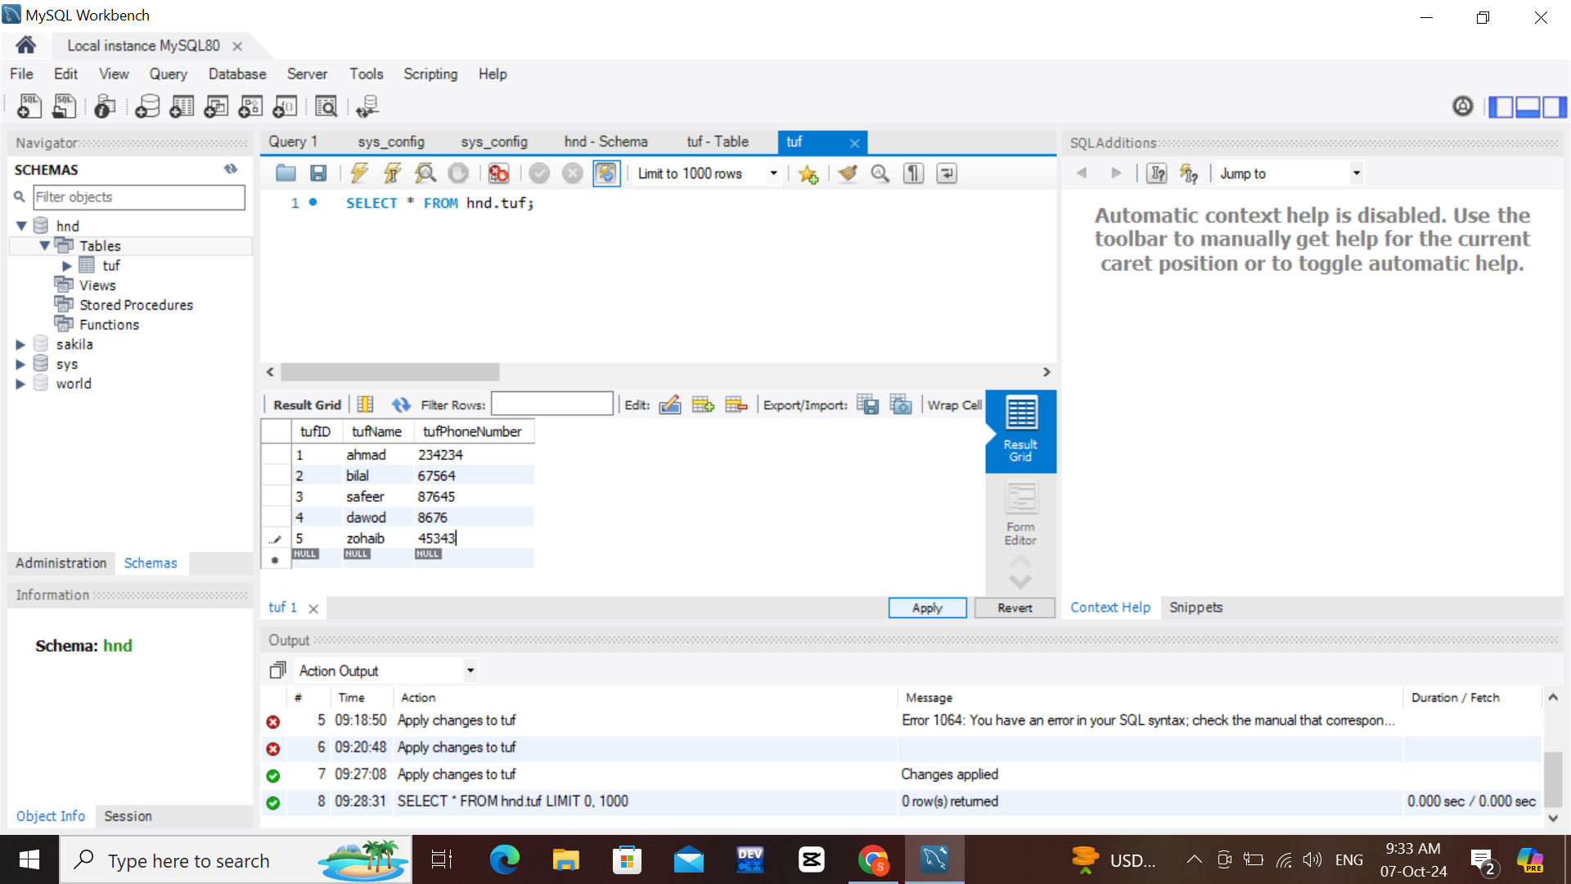
www.tuf.edu.pk
unioffaisalabad

Slide 47
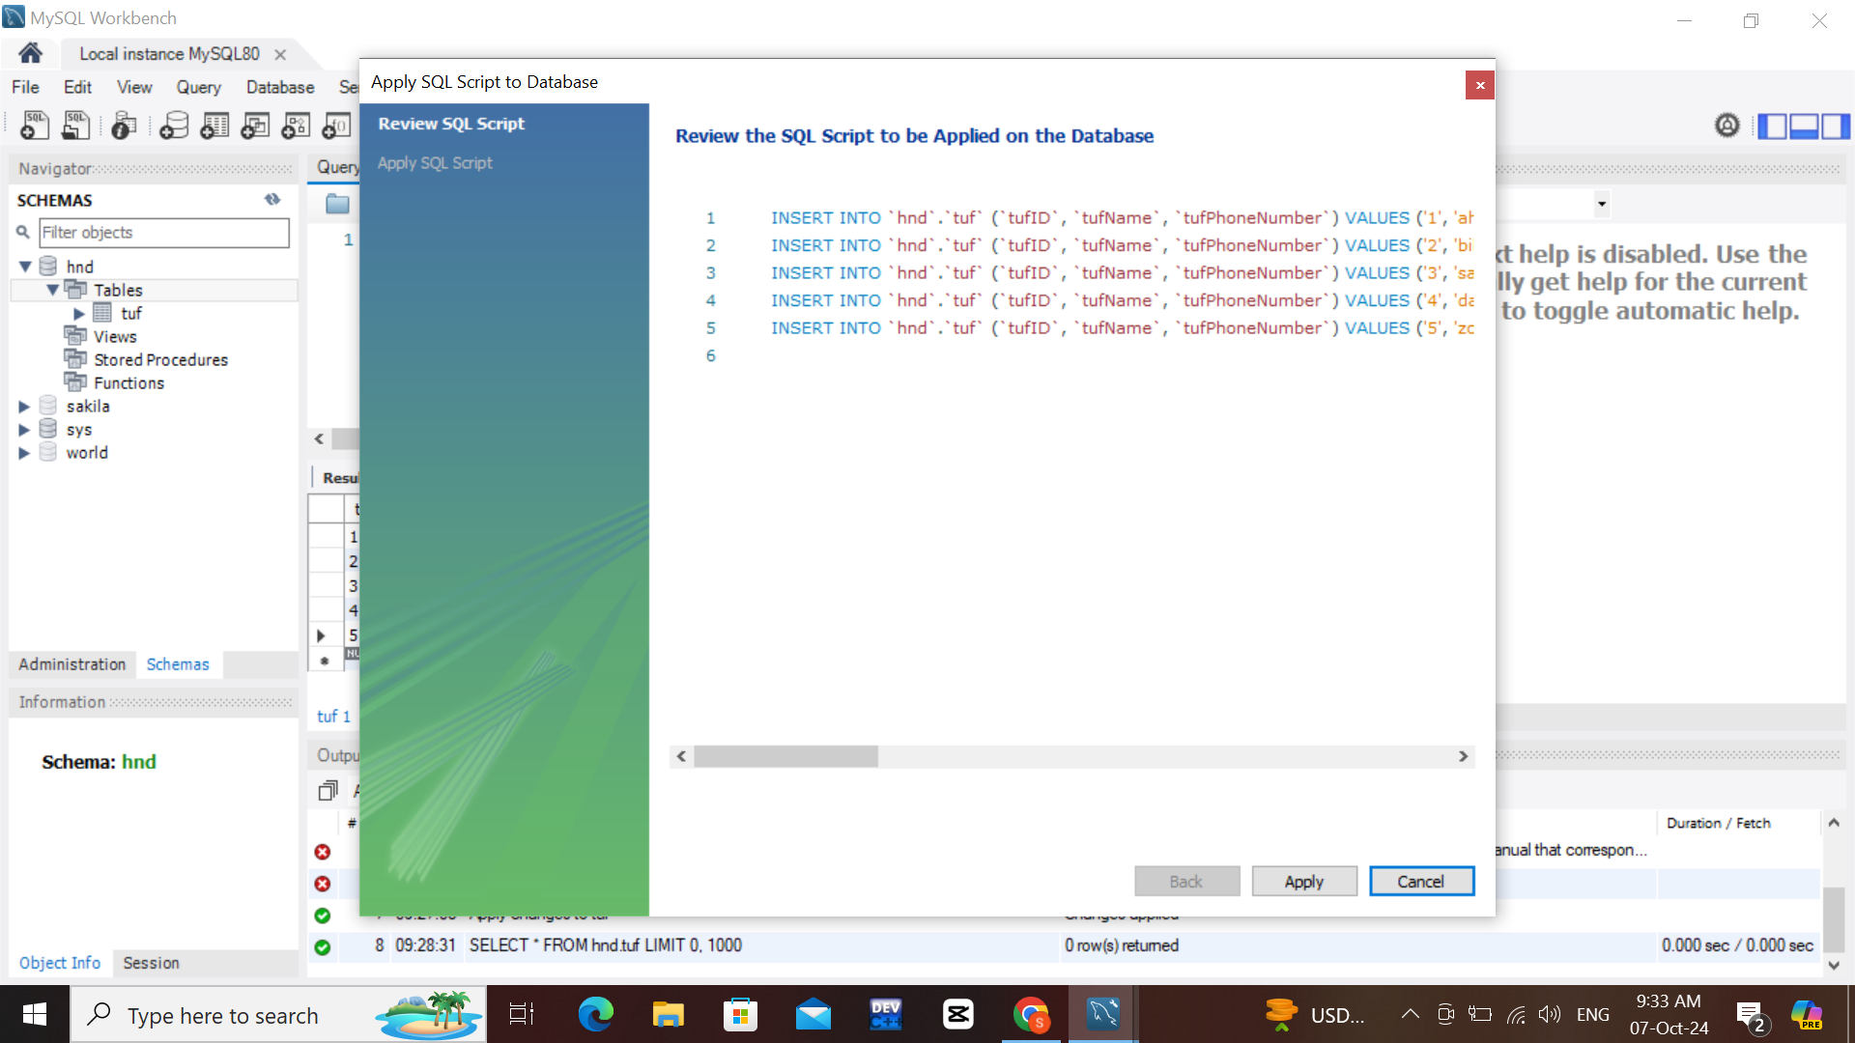
www.tuf.edu.pk
unioffaisalabad

Slide 48

www.tuf.edu.pk
unioffaisalabad

Slide 49
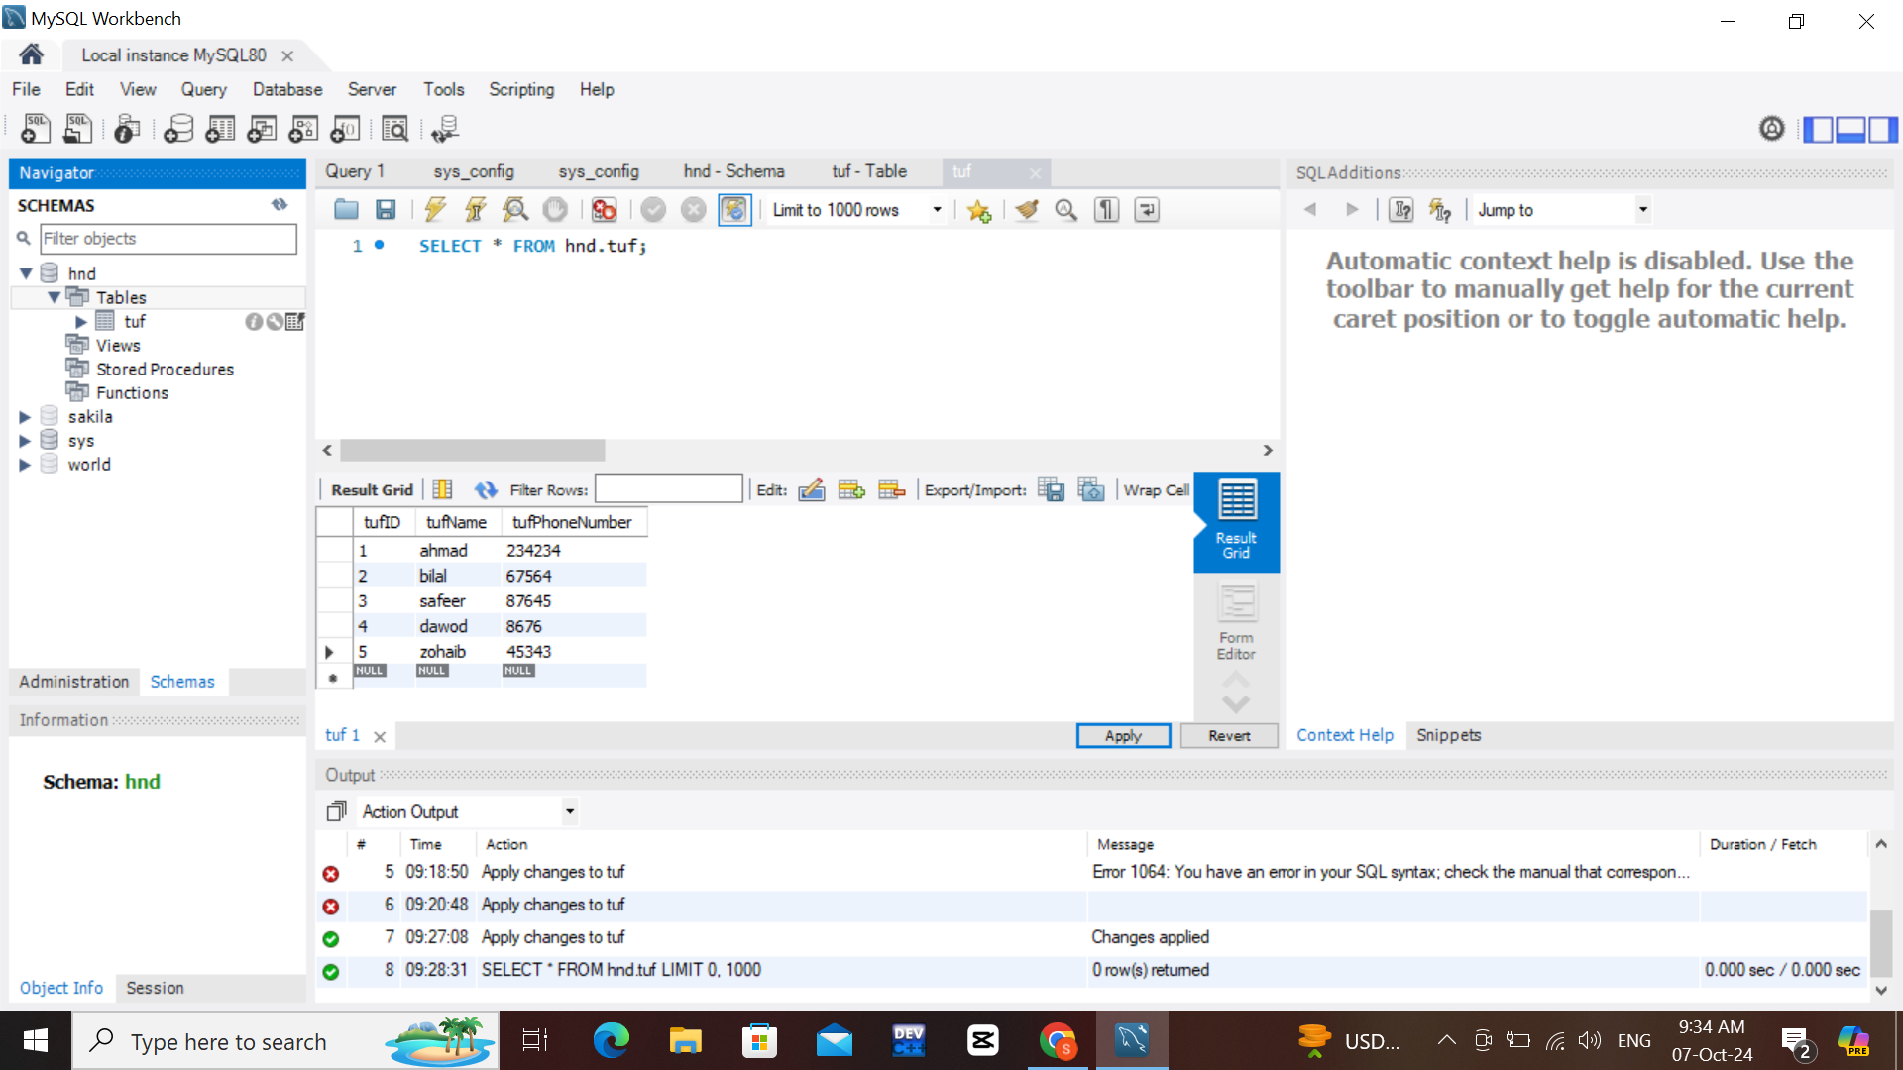
www.tuf.edu.pk
unioffaisalabad

Slide 50
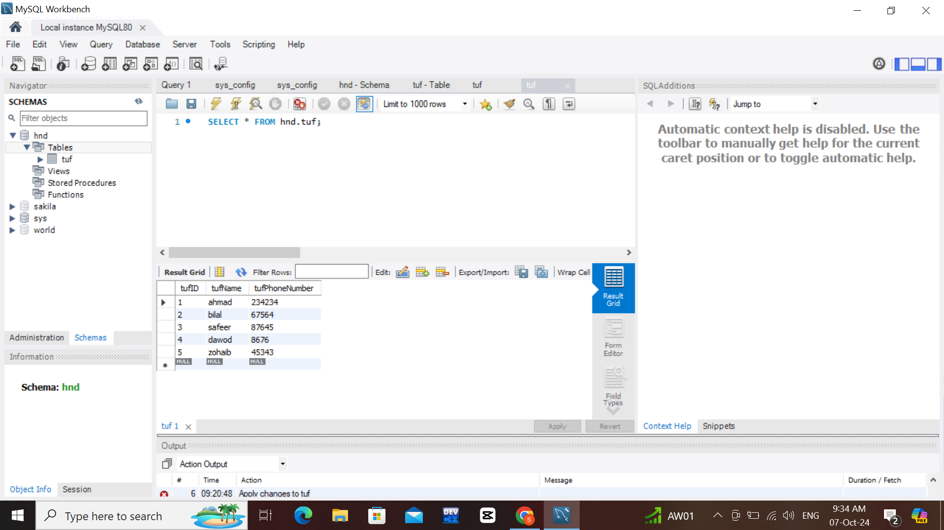
www.tuf.edu.pk
unioffaisalabad

